Slide 1
CEG5304 / EE6934 (PT2)
Lecture 8:
(Introduction to)
Deep Reinforcement Learning

Slide 2
Admin Issues for Week 8
CA#2: 30%. 15 Mar 24’ – 19 Apr 2024 1800 SGT.
Will be released (most probably) on Friday, will go through next Tuesday (19 Mar 24’).
1st Guest Lecture (19 Mar 24’)

Slide 3
Reinforcement Learning: The Basics
Applications of DRL
Notations in DRL

Slide 4
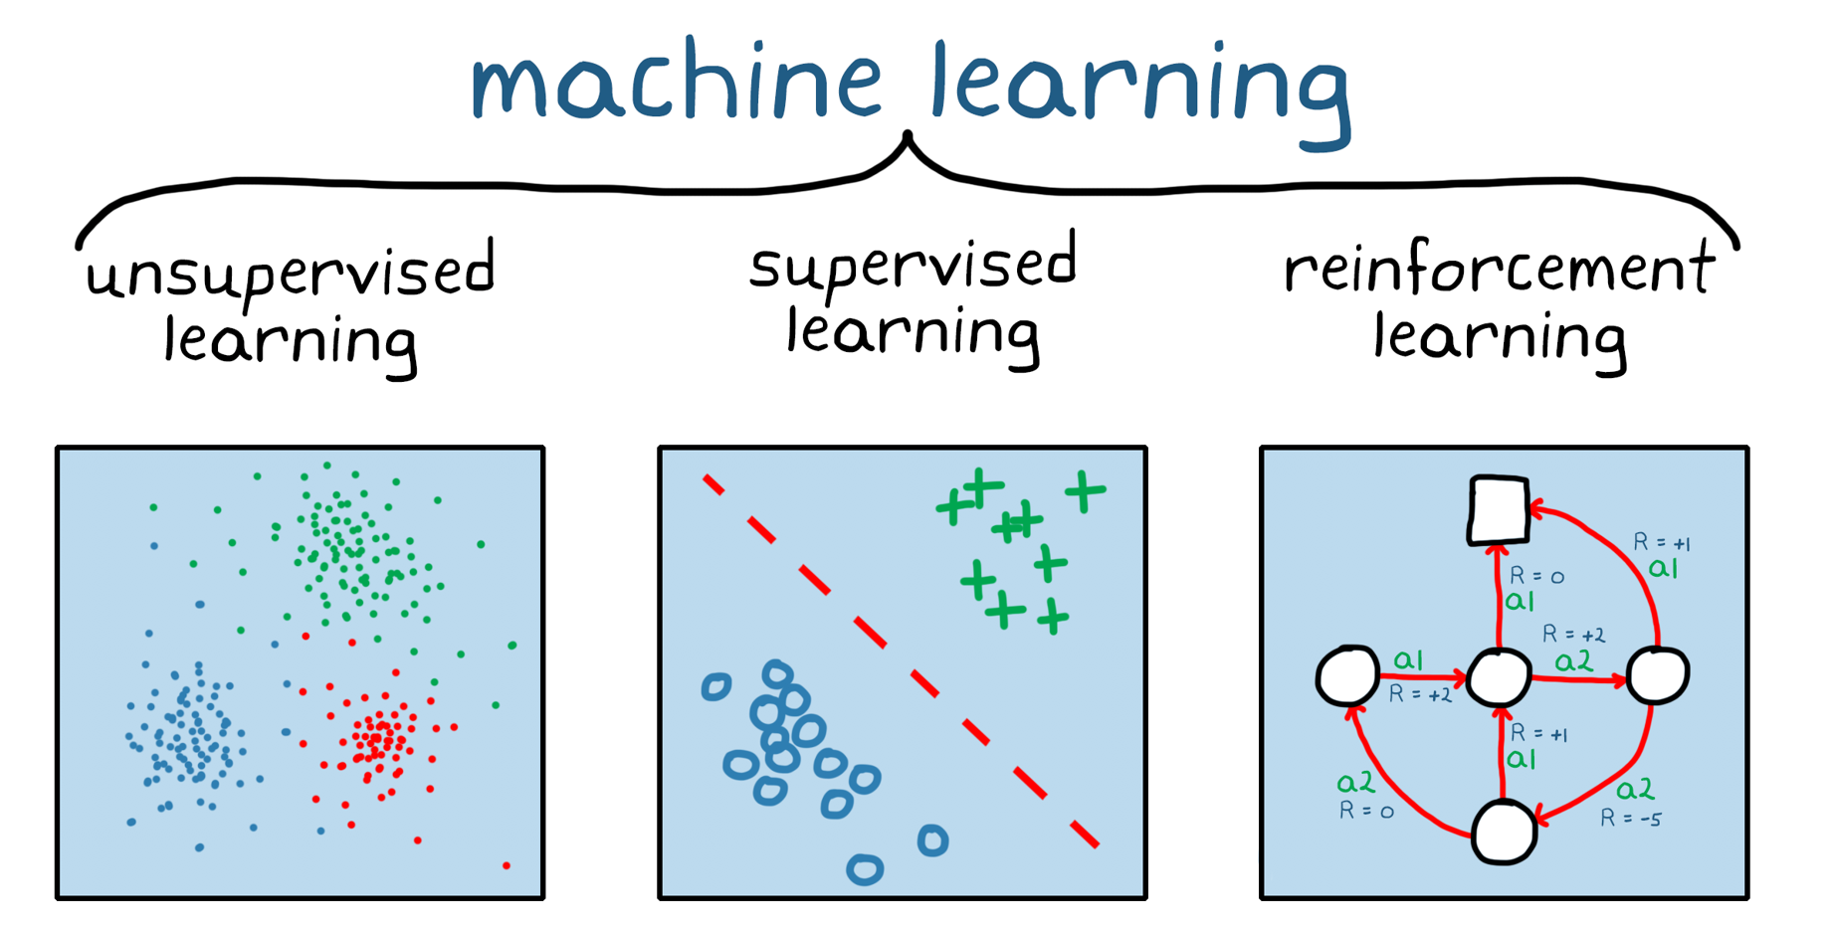

What is (Deep) Reinfocement Learning (DRL)
Reinforcement learning (RL): one of three basic machine learning paradigms, alongside supervised learning and unsupervised learning.
RL is concerned with how an intelligent agent ought to take actions in a dynamic environment in order to maximize the cumulative reward.
Learning with feedback from the environment.

Slide 5
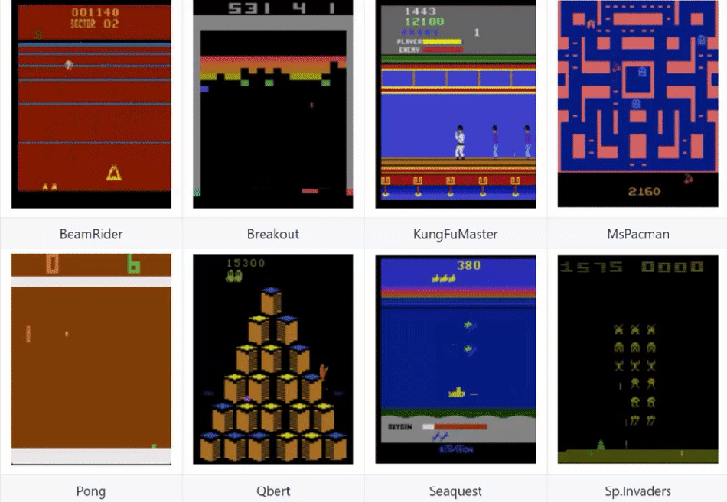
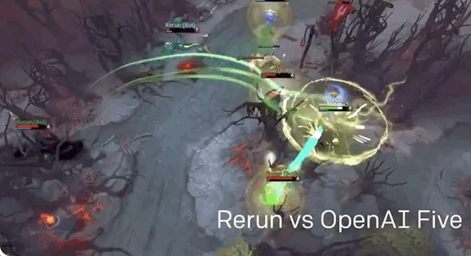
Examples of Reinforcement Learning
Playing video games (DOTA 2, Atari Games)

Slide 6
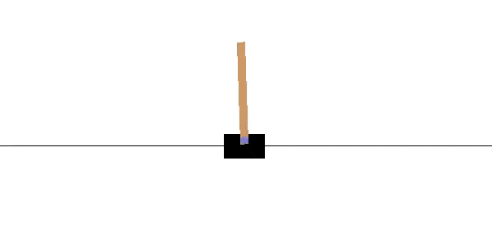
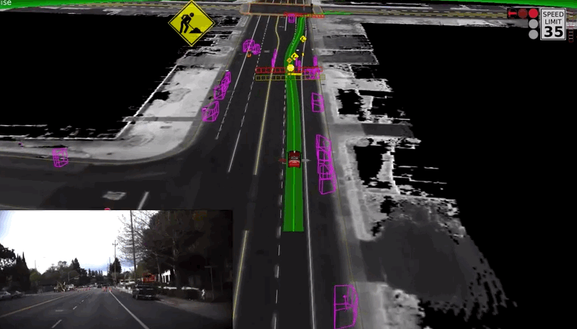
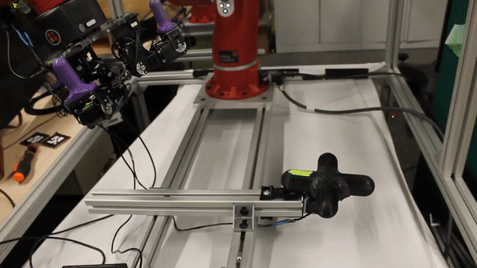
Examples of Reinforcement Learning
Autonomous control (autonomous driving, robot control)
Notes:
The simple and classic “robot control”: cart-pole control

Slide 7
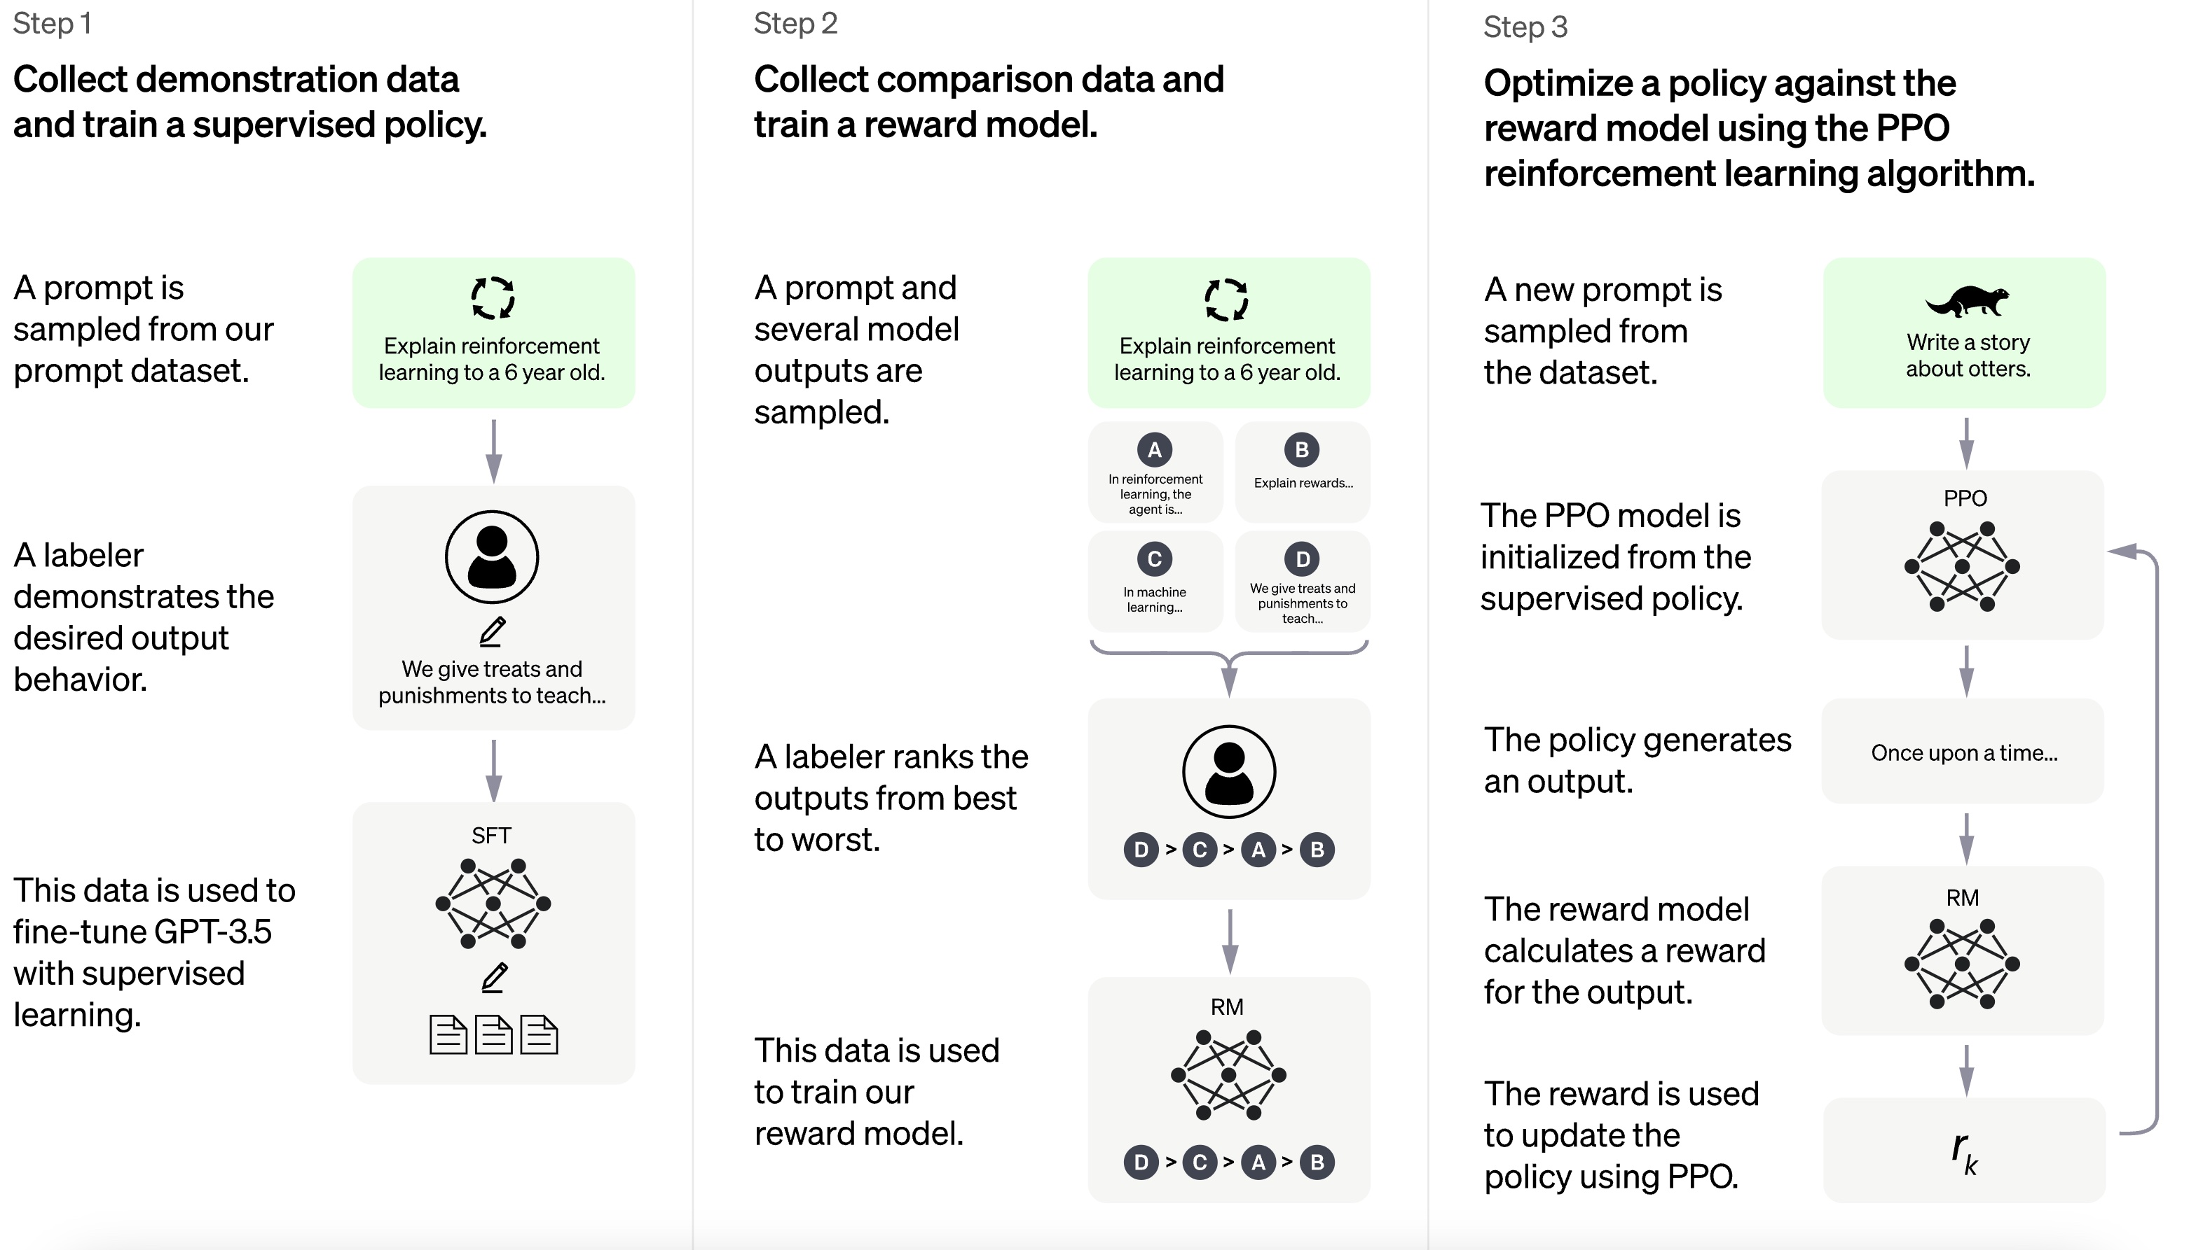
More Examples of Reinforcement Learning
Natural language Processing (NLP, ChatGPT)
Notes:
NLP, especially ChatGPT: RLHF reinforcement learning from human feedback

Slide 8
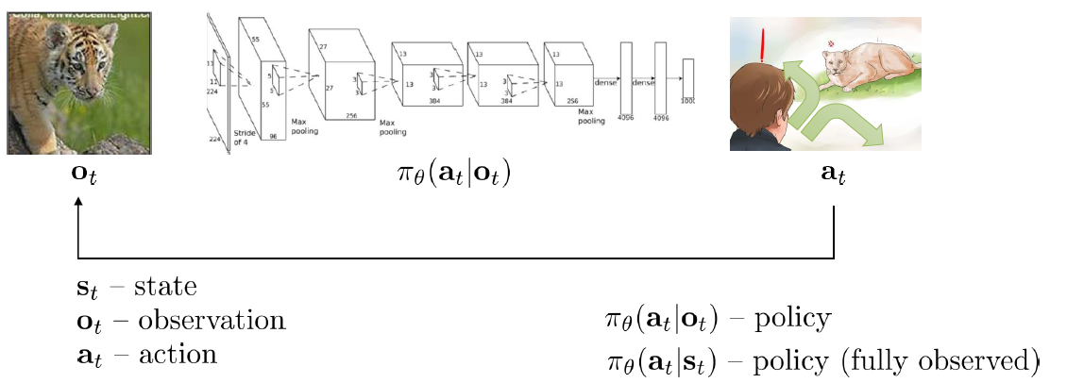
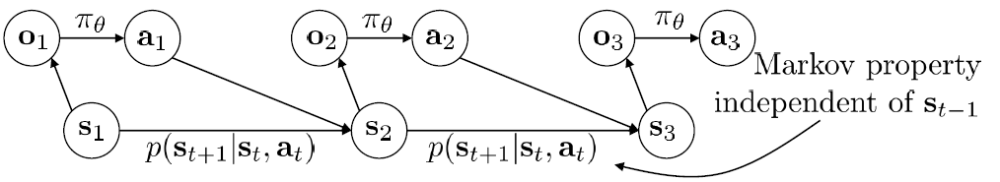
Overview of Reinforcement Learning
How to characterize RL?
States, Observations, and Actions. (What are the other notations?)
Expressing the RL process in a sequence with Markov property.

Slide 9

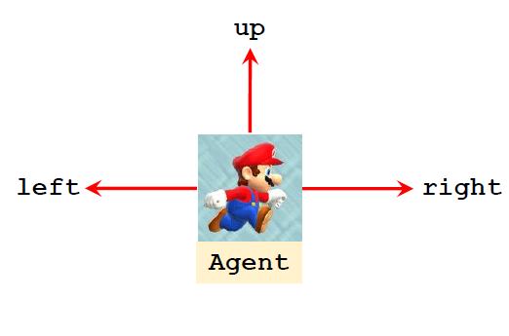



Reinforcement Learning: Notations
Discuss RL with a Mario game: scoring the largest points when traveling from the start to finish (and try not to die).
State $s$: this frame
Action $a∈\{left, right, up\}$
Observation $o$: (partial) frame
Assume (mostly) $s=o$: fully observed

Slide 10
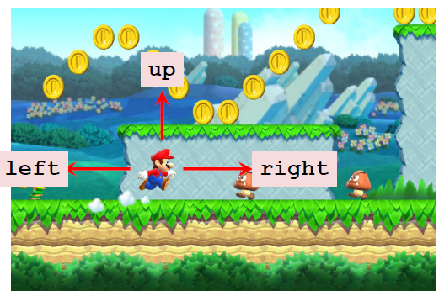
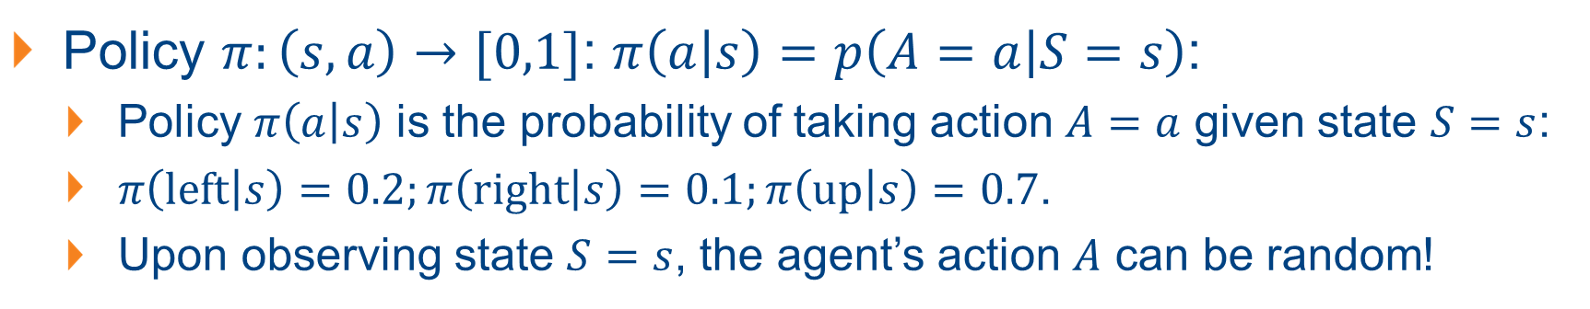
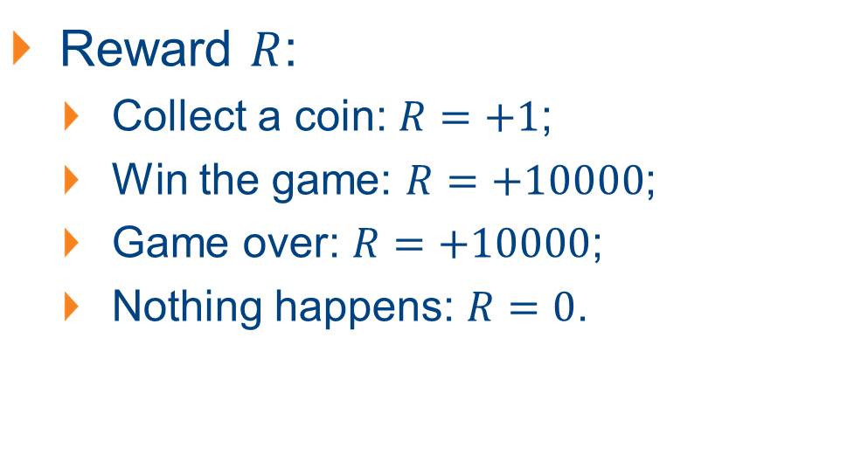
Notations and Terminologies
Policy $π:\left(s,a\right)→[0,1]$: $π\left(a | s\right)=p\left(A=a | S=s\right)$:
Policy $π\left(a | s\right)$ is the probability of taking action $A=a$ given state $S=s$:
$π\left(left | s\right)=0.2;π\left(right | s\right)=0.1;π\left(up | s\right)=0.7$.
Upon observing state $S=s$, the agent’s action $A$ can be random!
Reward $R$:
Collect a coin: $R=+1$;
Win the game: $R=+10000$;
Game over: $R=+10000$;
Nothing happens: $R=0$.

Slide 11
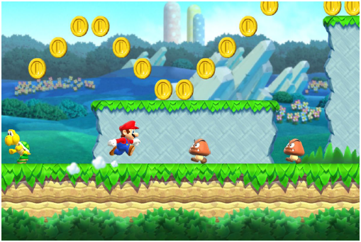
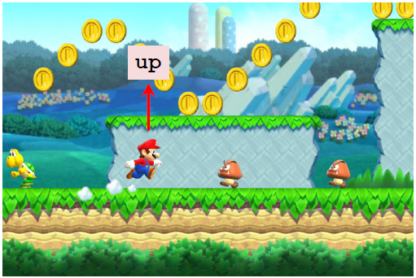
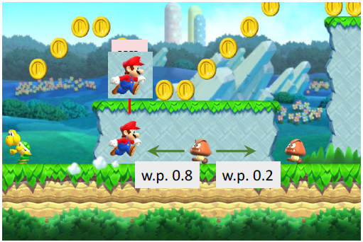
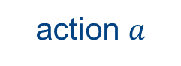
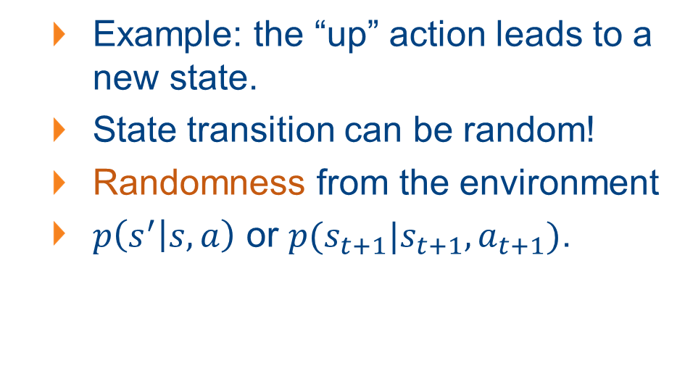
Notations and Terminologies
State transition: transition from an “old state” to a “new state” due to some “action”
Old state
action $a$
New state
Example: the “up” action leads to a new state.
State transition can be random!
Randomness from the environment
$p\left(s^{′} | s,a\right)$ or $p(s_{t+1}|s_{t+1}, a_{t+1})$.

Slide 12
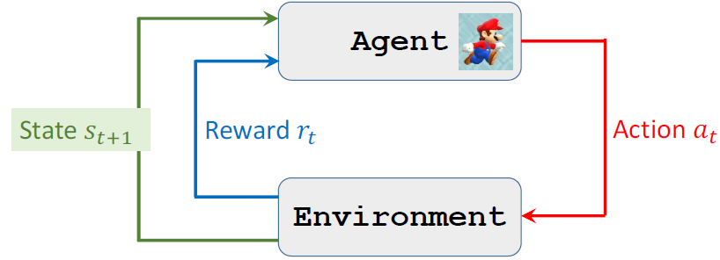
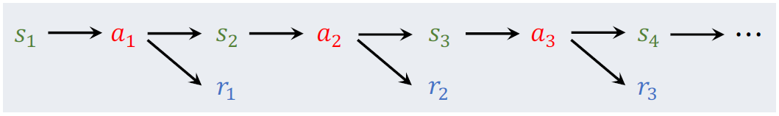
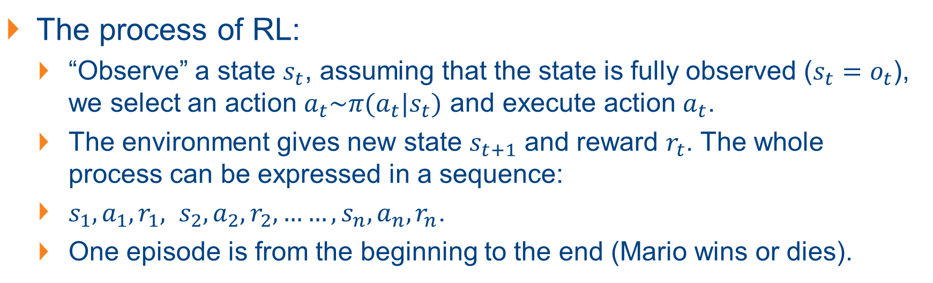
The Core – Agent-Environment Interaction
The process of RL:
“Observe” a state $s_{t}$, assuming that the state is fully observed ($s_{t}=o_{t}$), we select an action $a_{t}\sim π(a_{t}|s_{t})$ and execute action $a_{t}$.
The environment gives new state $s_{t+1}$ and reward $r_{t}$. The whole process can be expressed in a sequence:
$s_{1},a_{1}, r_{1}, s_{2}, a_{2}, r_{2}, ……, s_{n}, a_{n}, r_{n}$.
One episode is from the beginning to the end (Mario wins or dies).

Slide 13
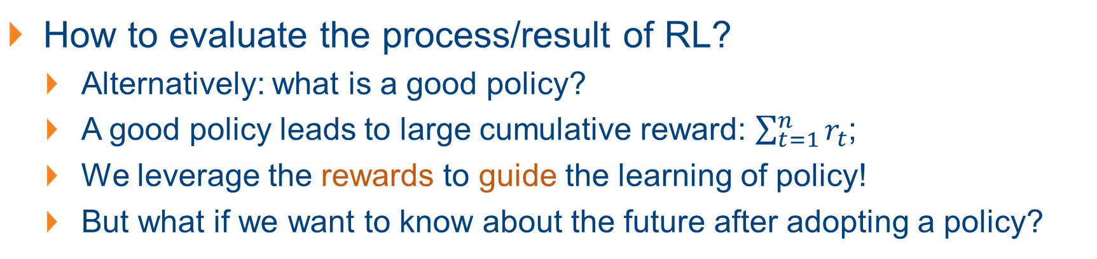
Agent-Environment Interaction
How to evaluate the process/result of RL?
Alternatively: what is a good policy?
A good policy leads to large cumulative reward: $\sum_{t=1}^{n}{r_{t}}$;
We leverage the rewards to guide the learning of policy!
But what if we want to know about the future after adopting a policy?

Slide 14
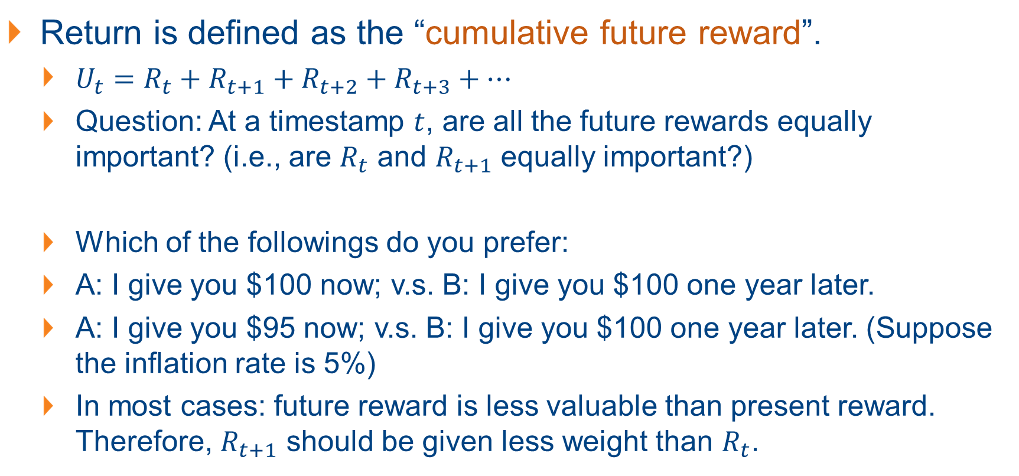
Guiding via Rewards and Returns
Return is defined as the “cumulative future reward”.
$U_{t}=R_{t}+R_{t+1}+R_{t+2}+R_{t+3}+…$
Question: At a timestamp $t$, are all the future rewards equally important? (i.e., are $R_{t}$ and $R_{t+1}$ equally important?)
Which of the followings do you prefer:
A: I give you $100 now; v.s. B: I give you $100 one year later.
A: I give you $95 now; v.s. B: I give you $100 one year later. (Suppose the inflation rate is 5%)
In most cases: future reward is less valuable than present reward. Therefore, $R_{t+1}$ should be given less weight than $R_{t}$.

Slide 15
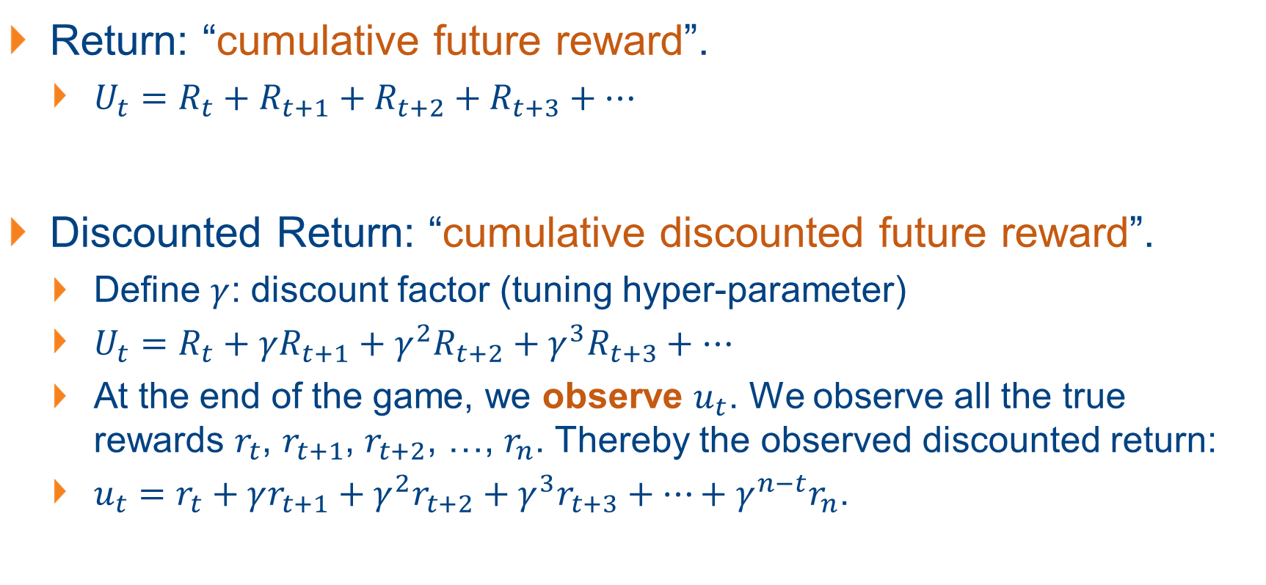
Discounted Returns
Return: “cumulative future reward”.
$U_{t}=R_{t}+R_{t+1}+R_{t+2}+R_{t+3}+…$
Discounted Return: “cumulative discounted future reward”.
Define $γ$: discount factor (tuning hyper-parameter)
$U_{t}=R_{t}+γR_{t+1}+γ^{2}R_{t+2}+γ^{3}R_{t+3}+…$
At the end of the game, we observe $u_{t}$. We observe all the true rewards $r_{t}$, $r_{t+1}$, $r_{t+2}$, …, $r_{n}$. Thereby the observed discounted return:
$u_{t}=r_{t}+γr_{t+1}+γ^{2}r_{t+2}+γ^{3}r_{t+3}+…+γ^{n−t}r_{n}$.

Slide 16
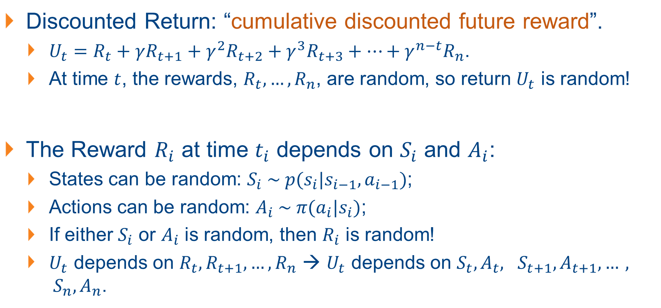
Randomness in Returns
Discounted Return: “cumulative discounted future reward”.
$U_{t}=R_{t}+γR_{t+1}+γ^{2}R_{t+2}+γ^{3}R_{t+3}+…+γ^{n−t}R_{n}$.
At time $t$, the rewards, $R_{t}, …, R_{n}$, are random, so return $U_{t}$ is random!
The Reward $R_{i}$ at time $t_{i}$ depends on $S_{i}$ and $A_{i}$:
States can be random: $S_{i} \sim p(s_{i}|s_{i−1}, a_{i−1})$;
Actions can be random: $A_{i} \sim π(a_{i}|s_{i})$;
If either $S_{i}$ or $A_{i}$ is random, then $R_{i}$ is random!
$U_{t}$ depends on $R_{t}, R_{t+1},…, R_{n}$ → $U_{t}$ depends on $S_{t},A_{t}, S_{t+1},A_{t+1},…, S_{n},A_{n}$.

Slide 17
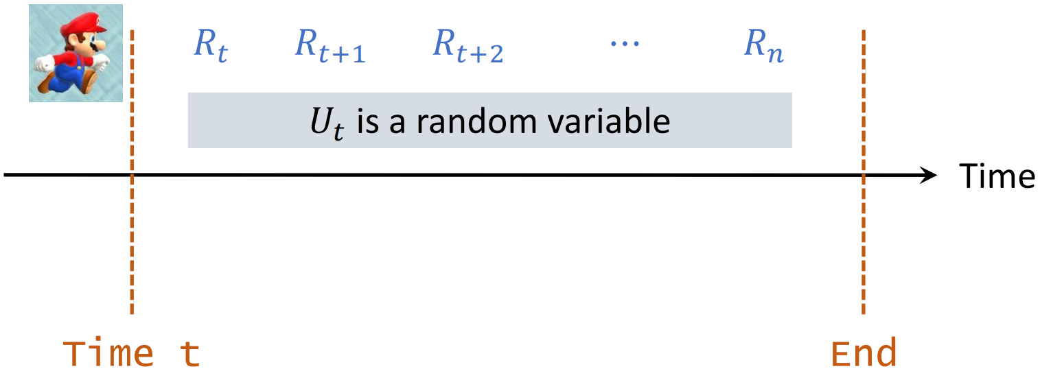
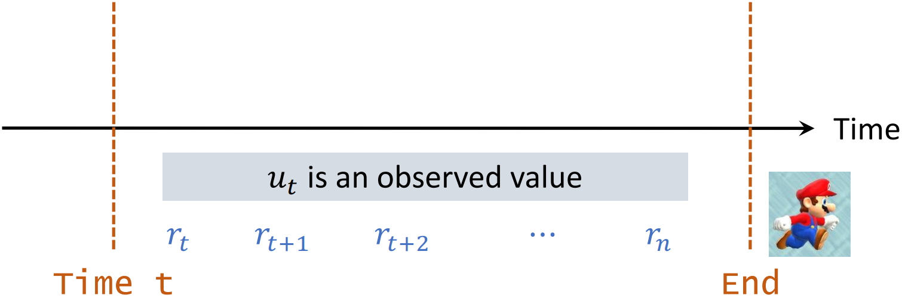
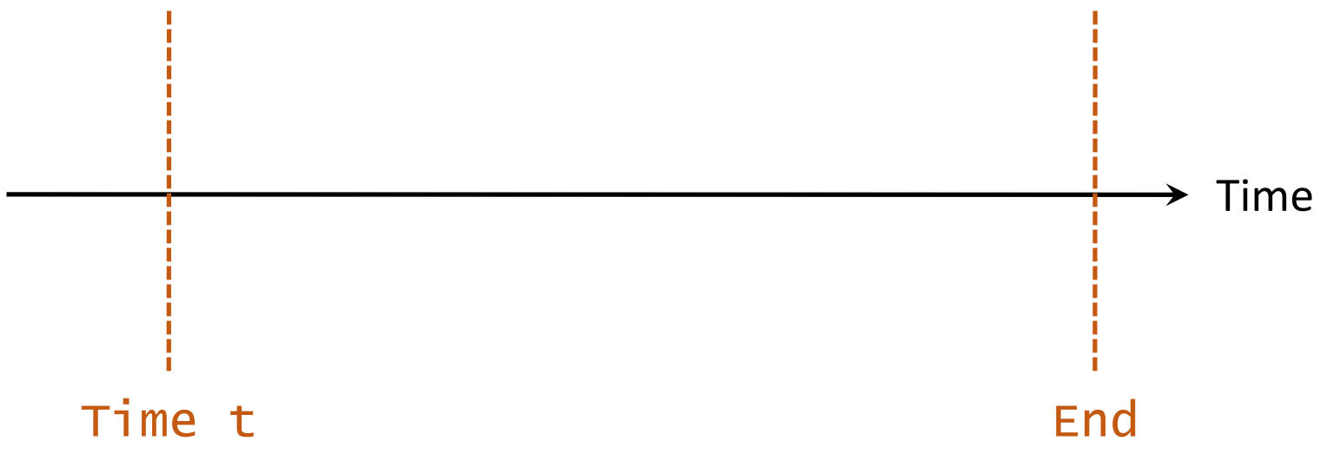
Randomness in Returns

Slide 18
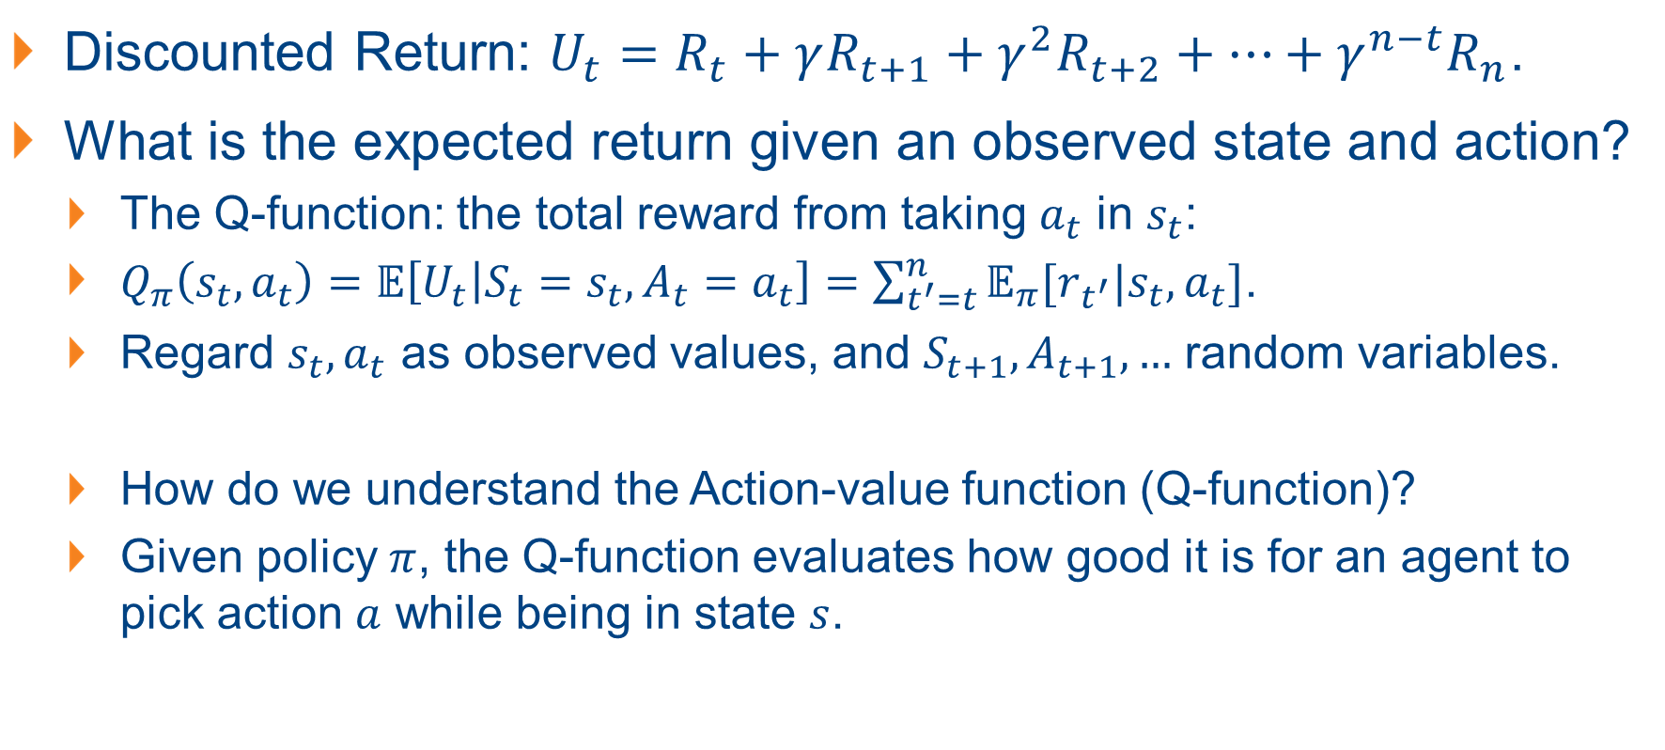
The Action-Value Funtion / Q-Function
Discounted Return: $U_{t}=R_{t}+γR_{t+1}+γ^{2}R_{t+2}+…+γ^{n−t}R_{n}$.
What is the expected return given an observed state and action?
The Q-function: the total reward from taking $a_{t}$ in $s_{t}$:
$Q_{π}\left(s_{t}, a_{t}\right)=𝔼\left[U_{t} | S_{t}=s_{t}, A_{t}=a_{t}\right]=\sum_{t^{′}=t}^{n}{𝔼_{π}[r_{t^{′}}|s_{t}, a_{t}]}$.
Regard $s_{t},a_{t}$ as observed values, and $S_{t+1}, A_{t+1}, …$ random variables.
How do we understand the Action-value function (Q-function)?
Given policy $π$, the Q-function evaluates how good it is for an agent to pick action $a$ while being in state $s$.

Slide 19
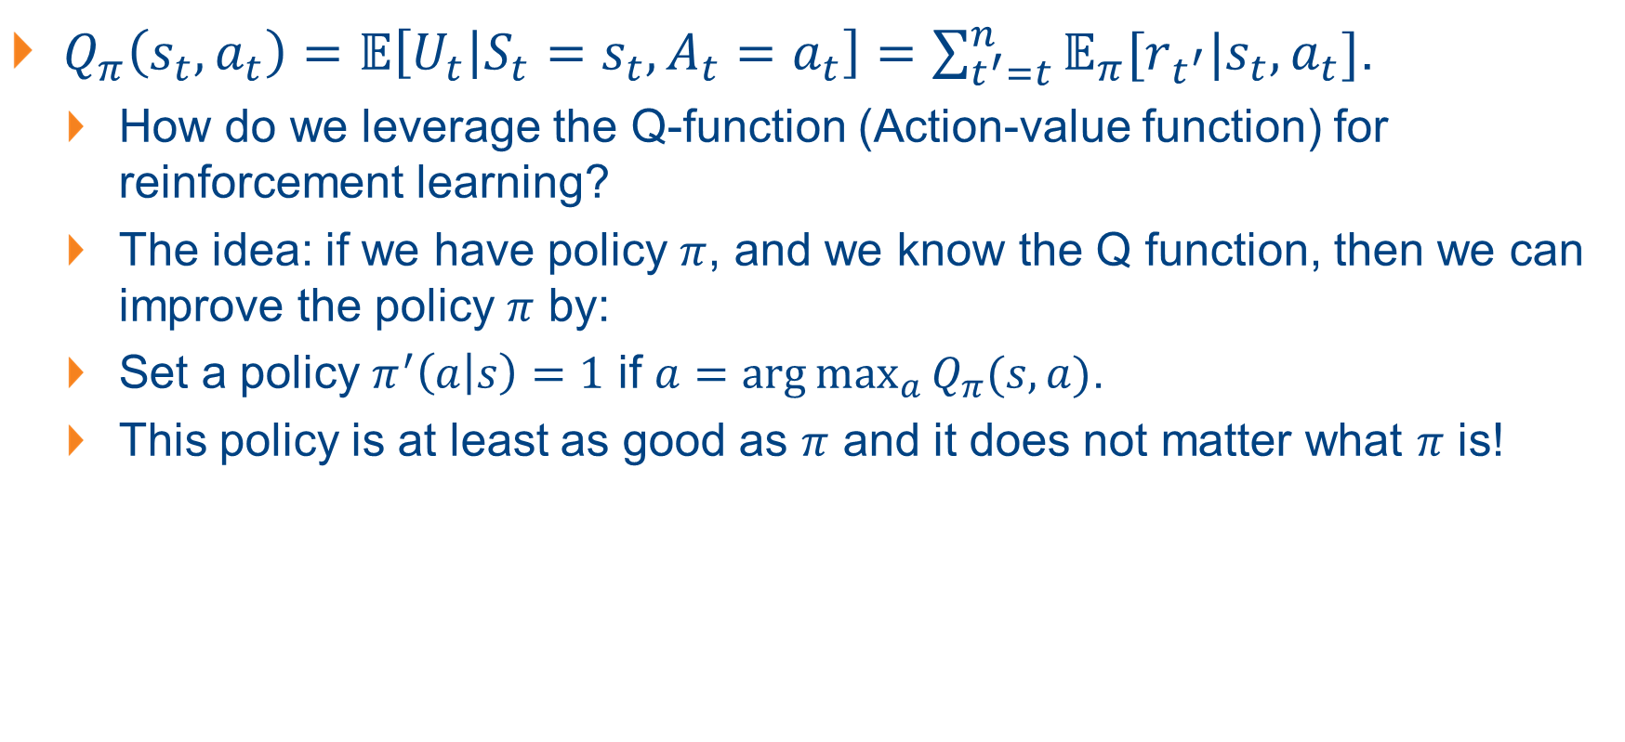
The Action-Value Funtion / Q-Function
$Q_{π}\left(s_{t}, a_{t}\right)=𝔼\left[U_{t} | S_{t}=s_{t}, A_{t}=a_{t}\right]=\sum_{t^{′}=t}^{n}{𝔼_{π}[r_{t^{′}}|s_{t}, a_{t}]}$.
How do we leverage the Q-function (Action-value function) for reinforcement learning?
The idea: if we have policy $π$, and we know the Q function, then we can improve the policy $π$ by:
Set a policy $π^{′}\left(a | s\right)=1$ if $a=\arg{\max_{a}{Q_{π}(s,a)}}$.
This policy is at least as good as $π$ and it does not matter what $π$ is!

Slide 20
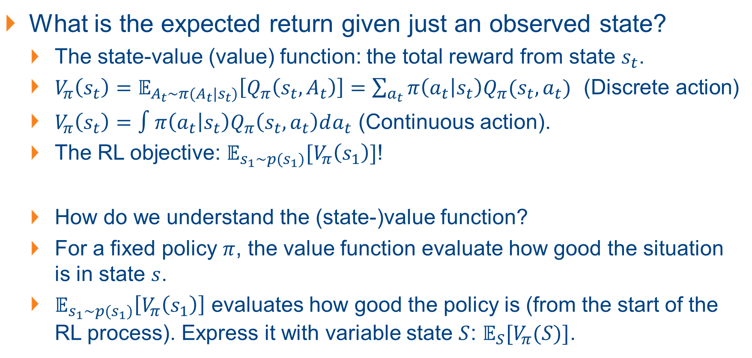
The State-Value Function / Value Function
What is the expected return given just an observed state?
The state-value (value) function: the total reward from state $s_{t}$.
$V_{π}\left(s_{t}\right)=𝔼_{A_{t}\sim π(A_{t}|s_{t})}\left[Q_{π}\left(s_{t}, A_{t}\right)\right]=\sum_{a_{t}}{π\left(a_{t} | s_{t}\right)Q_{π}(s_{t}, a_{t})}$ (Discrete action)
$V_{π}\left(s_{t}\right)=∫π\left(a_{t} | s_{t}\right)Q_{π}\left(s_{t}, a_{t}\right)da_{t}$ (Continuous action).
The RL objective: $𝔼_{s_{1}\sim p(s_{1})}[V_{π}\left(s_{1}\right)]$!
How do we understand the (state-)value function?
For a fixed policy $π$, the value function evaluate how good the situation is in state $s$.
$𝔼_{s_{1}\sim p(s_{1})}\left[V_{π}\left(s_{1}\right)\right]$ evaluates how good the policy is (from the start of the RL process). Express it with variable state $S$: $𝔼_{S}[V_{π}(S)]$.

Slide 21
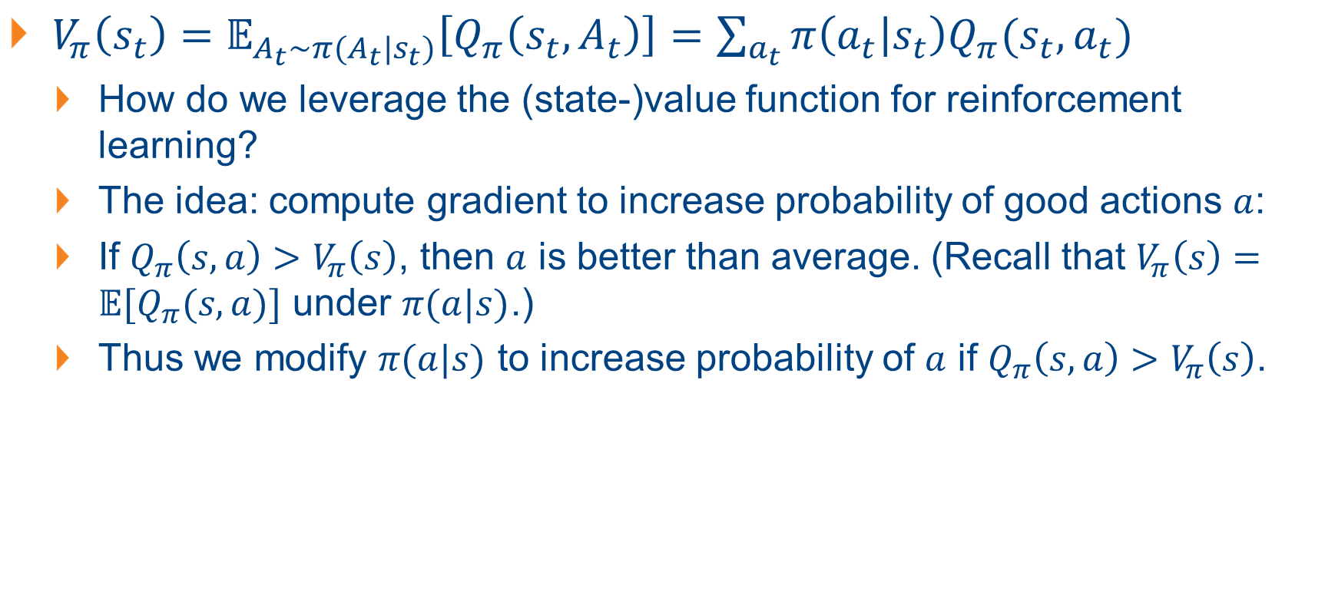
The State-Value Function / Value Function
$V_{π}\left(s_{t}\right)=𝔼_{A_{t}\sim π(A_{t}|s_{t})}\left[Q_{π}\left(s_{t}, A_{t}\right)\right]=\sum_{a_{t}}{π\left(a_{t} | s_{t}\right)Q_{π}(s_{t}, a_{t})}$
How do we leverage the (state-)value function for reinforcement learning?
The idea: compute gradient to increase probability of good actions $a$:
If $Q_{π}\left(s,a\right)>V_{π}\left(s\right)$, then $a$ is better than average. (Recall that $V_{π}\left(s\right)=𝔼[Q_{π}(s,a)]$ under $π(a|s)$.)
Thus we modify $π(a|s)$ to increase probability of $a$ if $Q_{π}\left(s,a\right)>V_{π}\left(s\right)$.

Slide 22
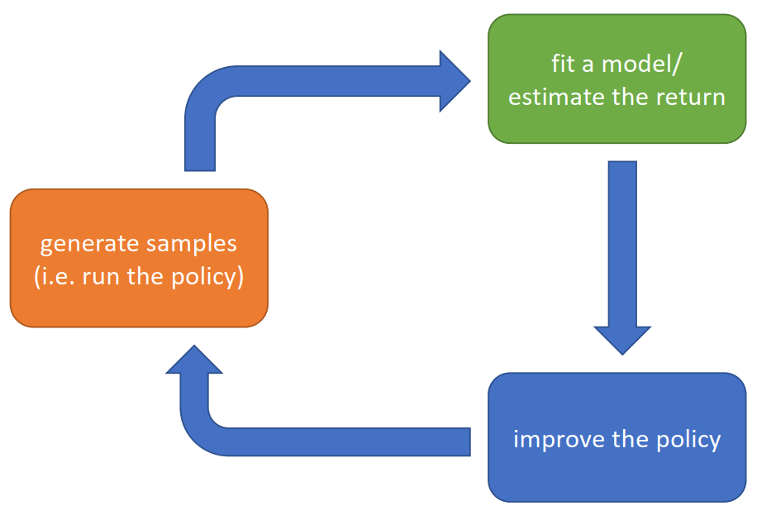
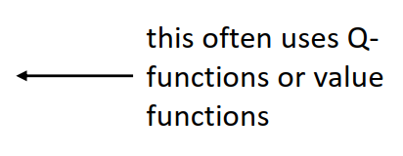
The Anatomy of a RL Algorithm

Slide 23

Evaluating RL Algorithms
How to evaluate the effectiveness of the RL algorithm?
A useful toolkit: the OpenAI Gym – developing and comparing reinforcement learning algorithms (gym.openai.com)
Two classical control problems: Cart pole and Pendulum

Slide 24
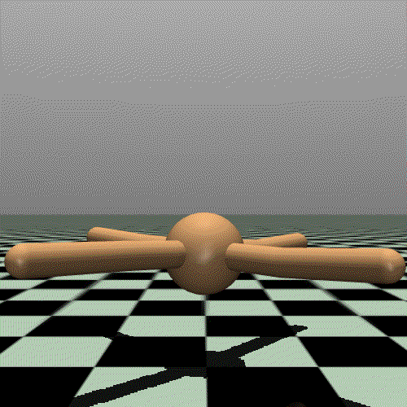
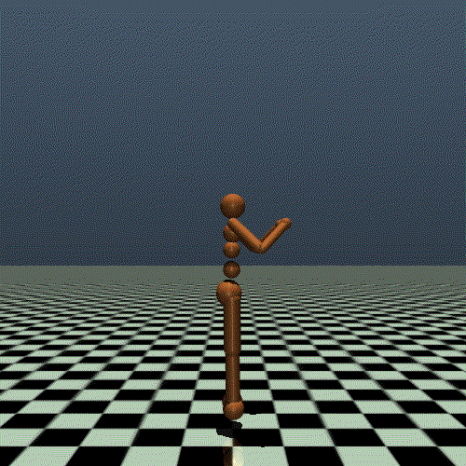
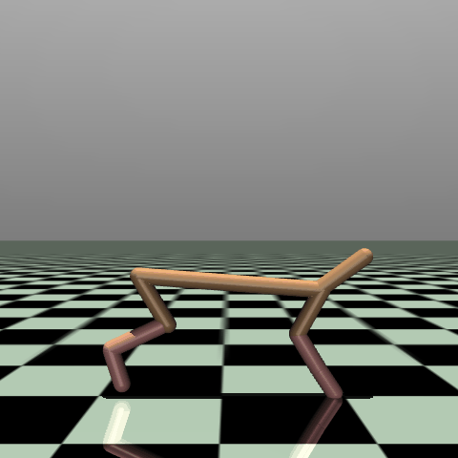
Evaluating RL Algorithms
Other classical RL evaluation scenarios: continuous control tasks with MuJuCo: ant, humanoid, half cheetah

Slide 25
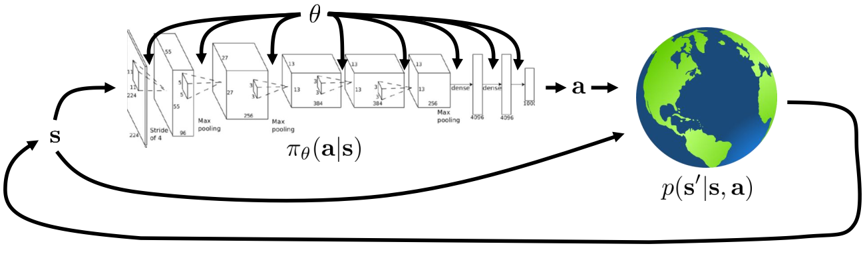
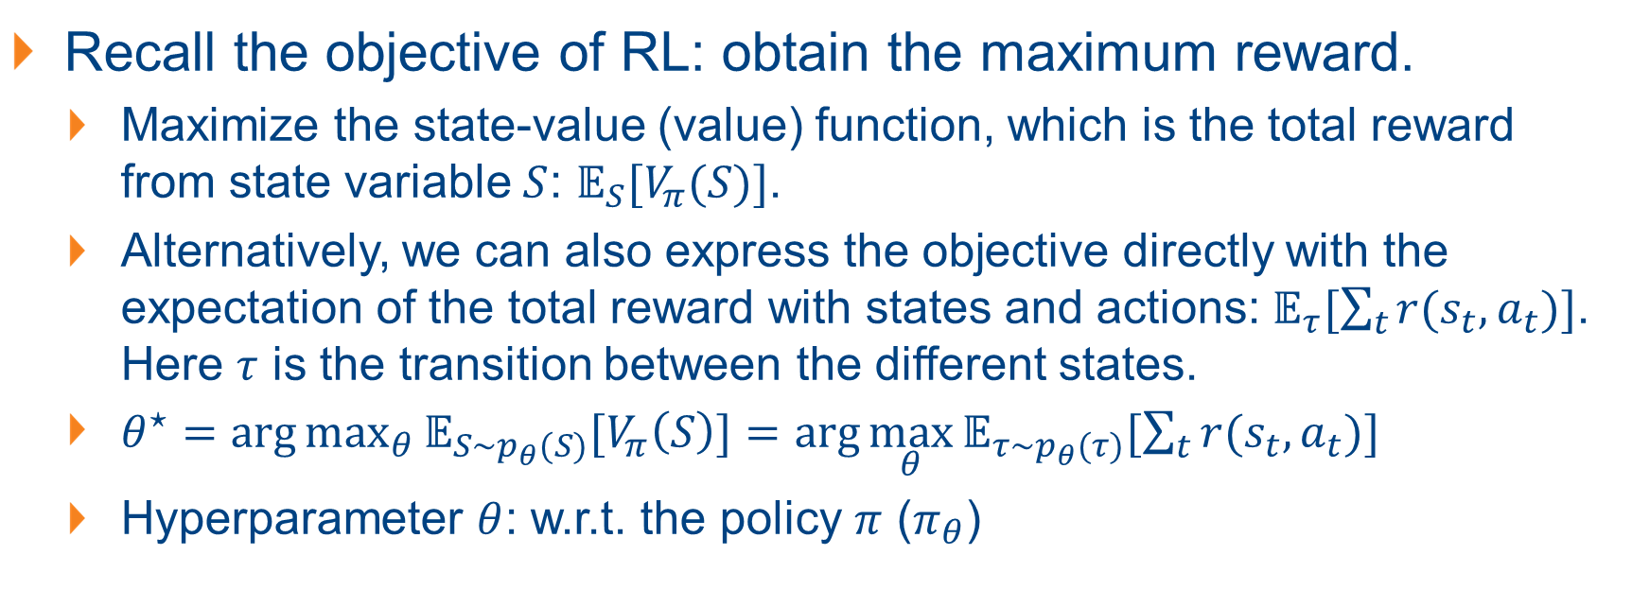
Types of RL Algorithms
Recall the objective of RL: obtain the maximum reward.
Maximize the state-value (value) function, which is the total reward from state variable $S$: $𝔼_{S}[V_{π}(S)]$.
Alternatively, we can also express the objective directly with the expectation of the total reward with states and actions: $𝔼_{τ}[\sum_{t}{r(s_{t},a_{t})}]$. Here $τ$ is the transition between the different states.
$θ^{⋆}=\arg{\max_{θ}{𝔼_{S\sim p_{θ}(S)}[V_{π}\left(S\right)]}}=$ $\arg{\max_{θ}{𝔼_{τ\sim p_{θ}(τ)}[\sum_{t}{r(s_{t},a_{t})}]}}$
Hyperparameter $θ$: w.r.t. the policy $π$ ($π_{θ}$)

Slide 26
Types of RL Algorithms
The different types of RL algorithms are different approaches to obtain the best (policy) model: (We discuss the basics)
* Value-based RL: directly estimate the action-value function or Q-function of the optimal policy (no explicit policy, directly the action);
* Policy-based RL: Optimize the RL objective to find the optimal policy (usually relates to the (state-)value function);
Actor-Critic: estimate the action-value function or Q-function of the current policy, and use it to improve the policy. (Combination of Value-based and Policy-based RL)

Slide 27
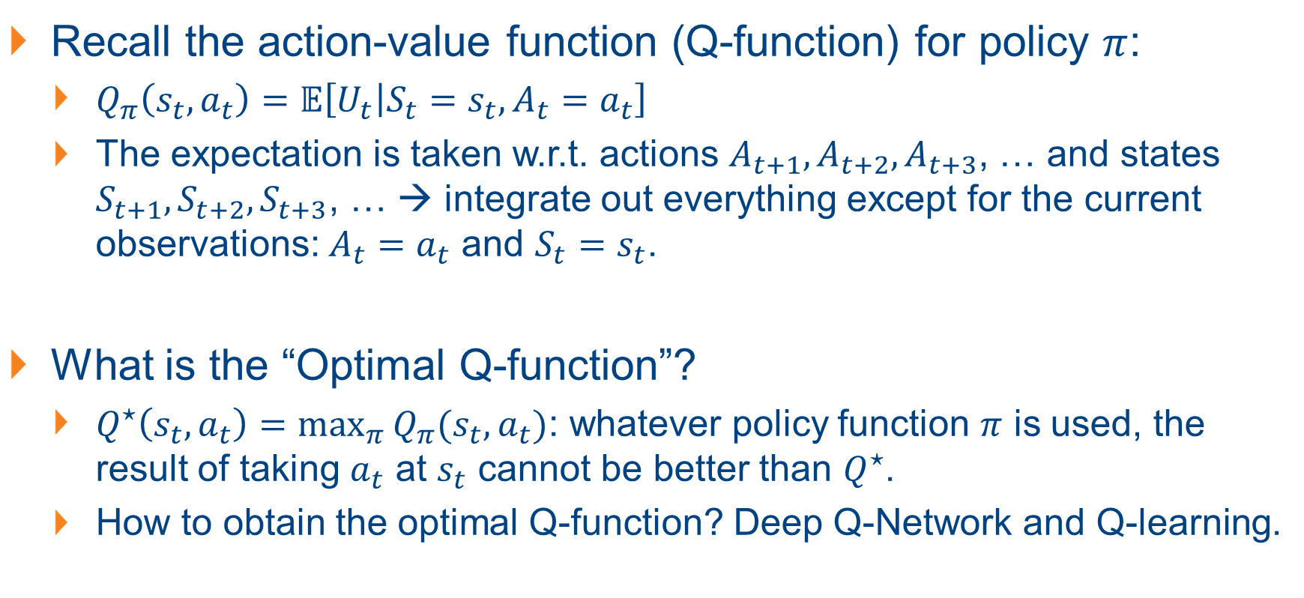
Value-Based RL
Recall the action-value function (Q-function) for policy $π$:
$Q_{π}\left(s_{t}, a_{t}\right)=𝔼\left[U_{t} | S_{t}=s_{t}, A_{t}=a_{t}\right]$
The expectation is taken w.r.t. actions $A_{t+1},A_{t+2},A_{t+3}$, … and states $S_{t+1},S_{t+2},S_{t+3}$, … → integrate out everything except for the current observations: $A_{t}=a_{t}$ and $S_{t}=s_{t}$.
What is the “Optimal Q-function”?
$Q^{⋆}\left(s_{t}, a_{t}\right)=\max_{π}{Q_{π}(s_{t}, a_{t})}$: whatever policy function $π$ is used, the result of taking $a_{t}$ at $s_{t}$ cannot be better than $Q^{⋆}$.
How to obtain the optimal Q-function? Deep Q-Network and Q-learning.

Slide 28
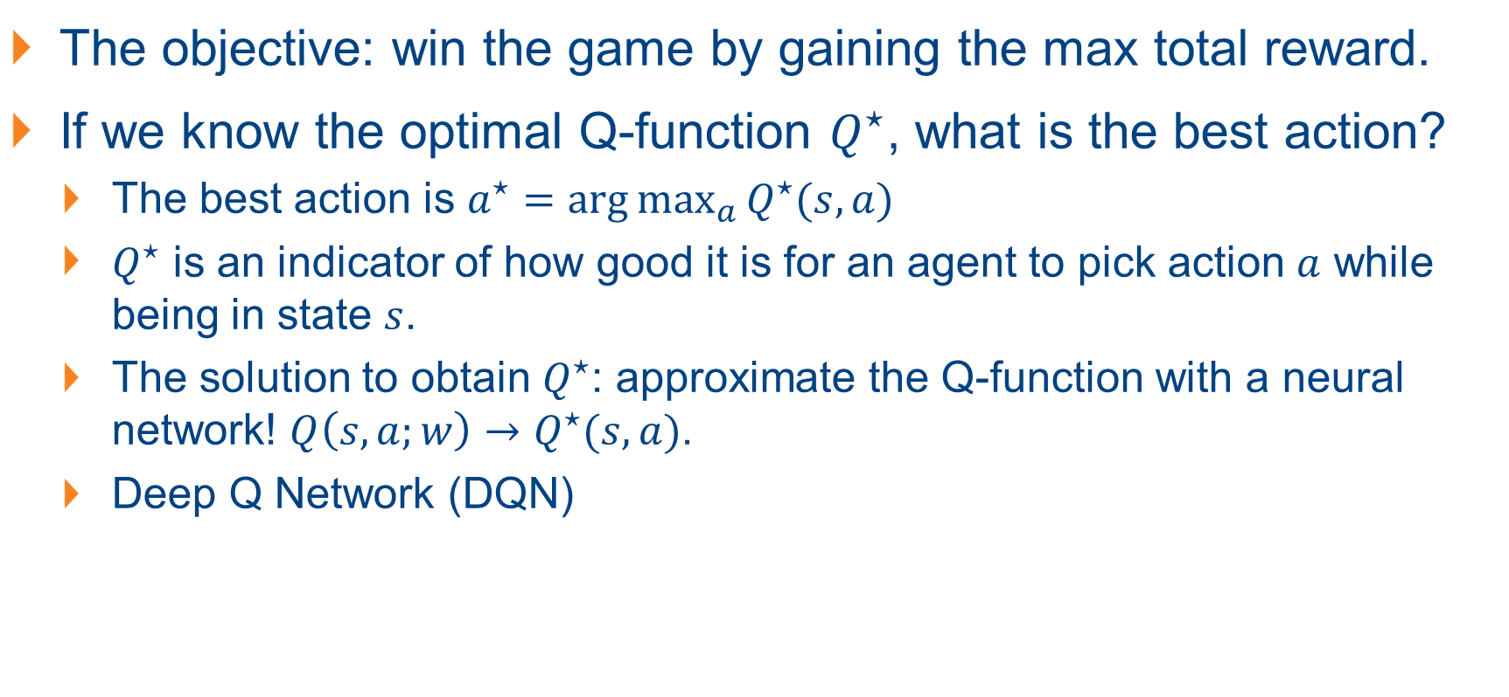
Deep Q-Network: Approx. the Q-Function
The objective: win the game by gaining the max total reward.
If we know the optimal Q-function $Q^{⋆}$, what is the best action?
The best action is $a^{⋆}=\arg{\max_{a}{Q^{⋆}(s,a)}}$
$Q^{⋆}$ is an indicator of how good it is for an agent to pick action $a$ while being in state $s$.
The solution to obtain $Q^{⋆}$: approximate the Q-function with a neural network! $Q\left(s,a;w\right)→Q^{⋆}(s,a)$.
Deep Q Network (DQN)

Slide 29
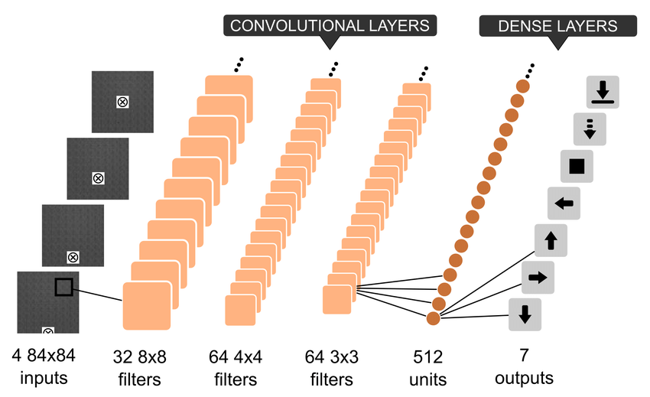
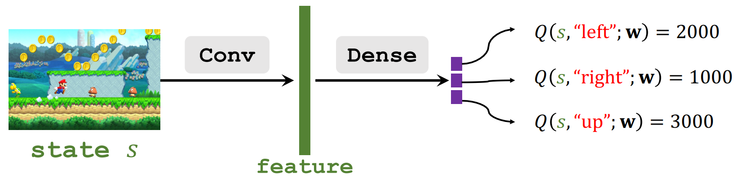
Deep Q Network (DQN): an Overview
What is the input and output of the DQN?
Input: The state (e.g., the screenshot or a series of screenshot); size: size of the state (e.g., screenshot)
Output: the Q-values for each action; size: dimension of action space.

Slide 30
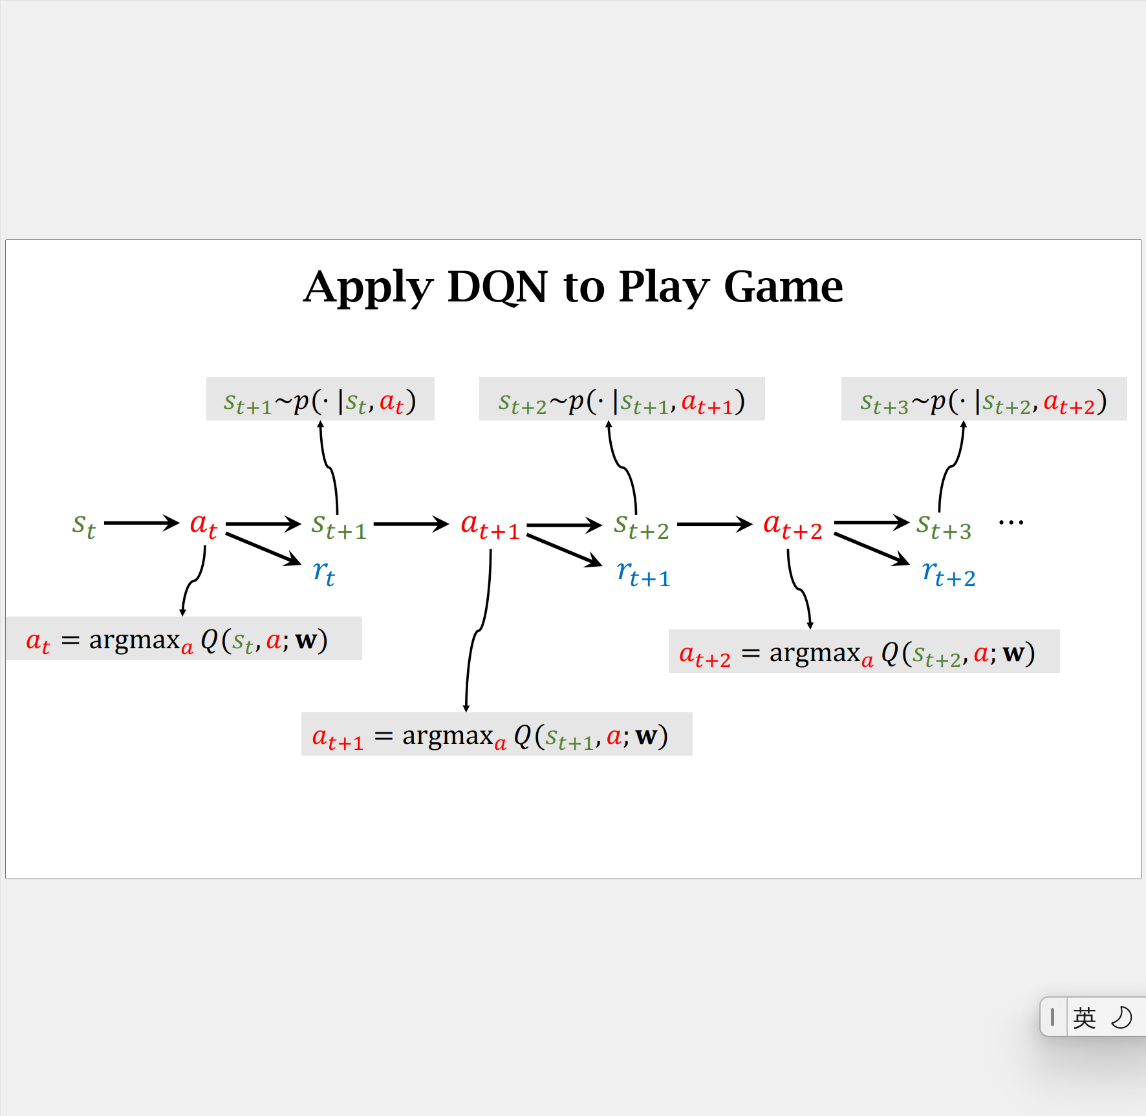
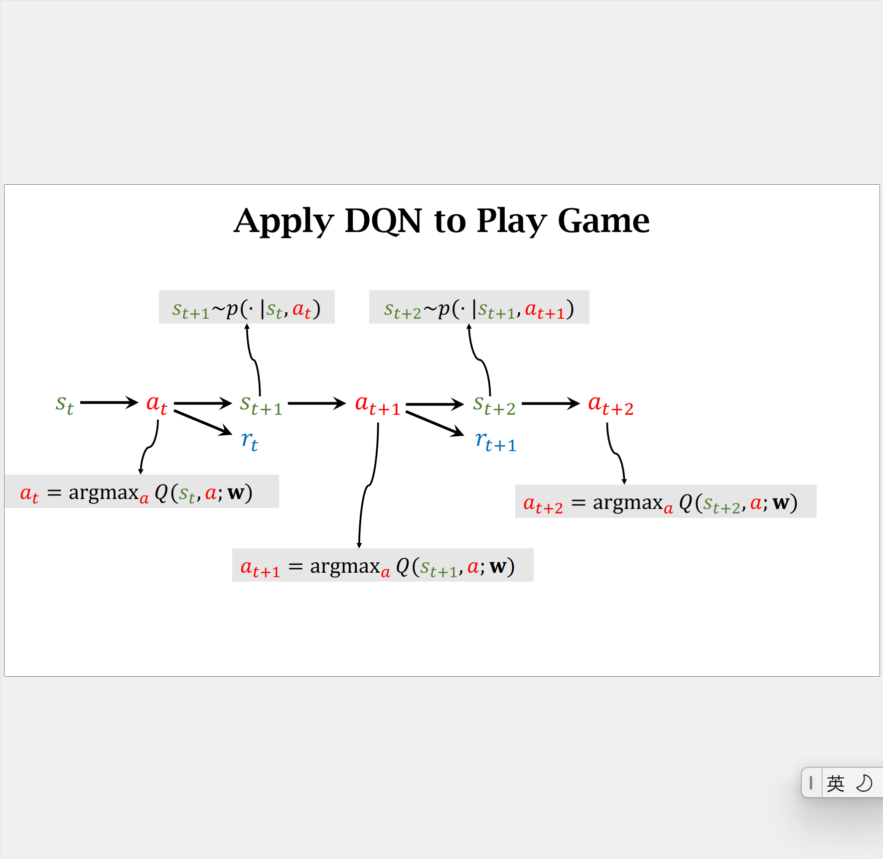
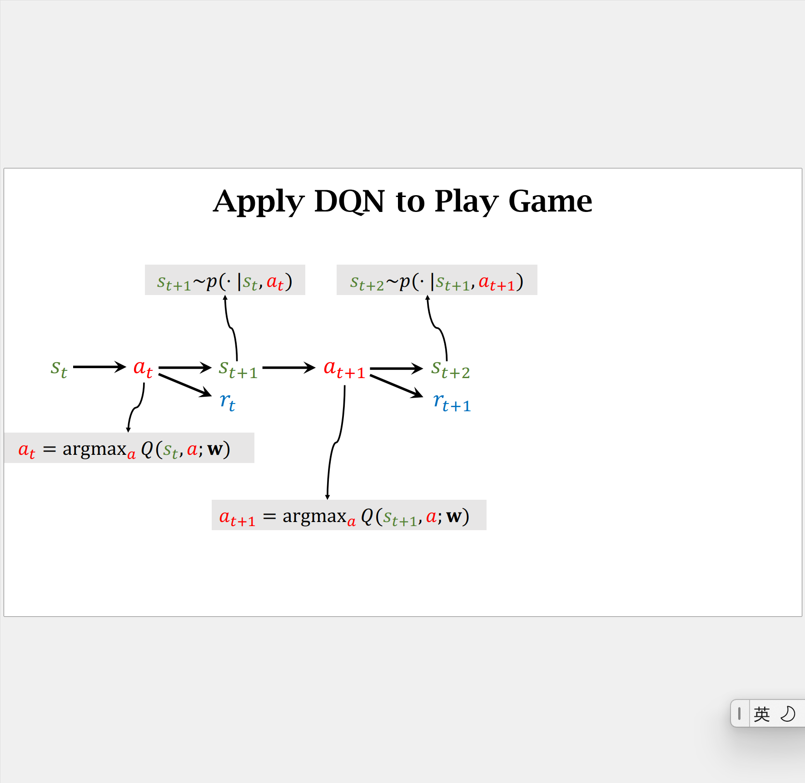
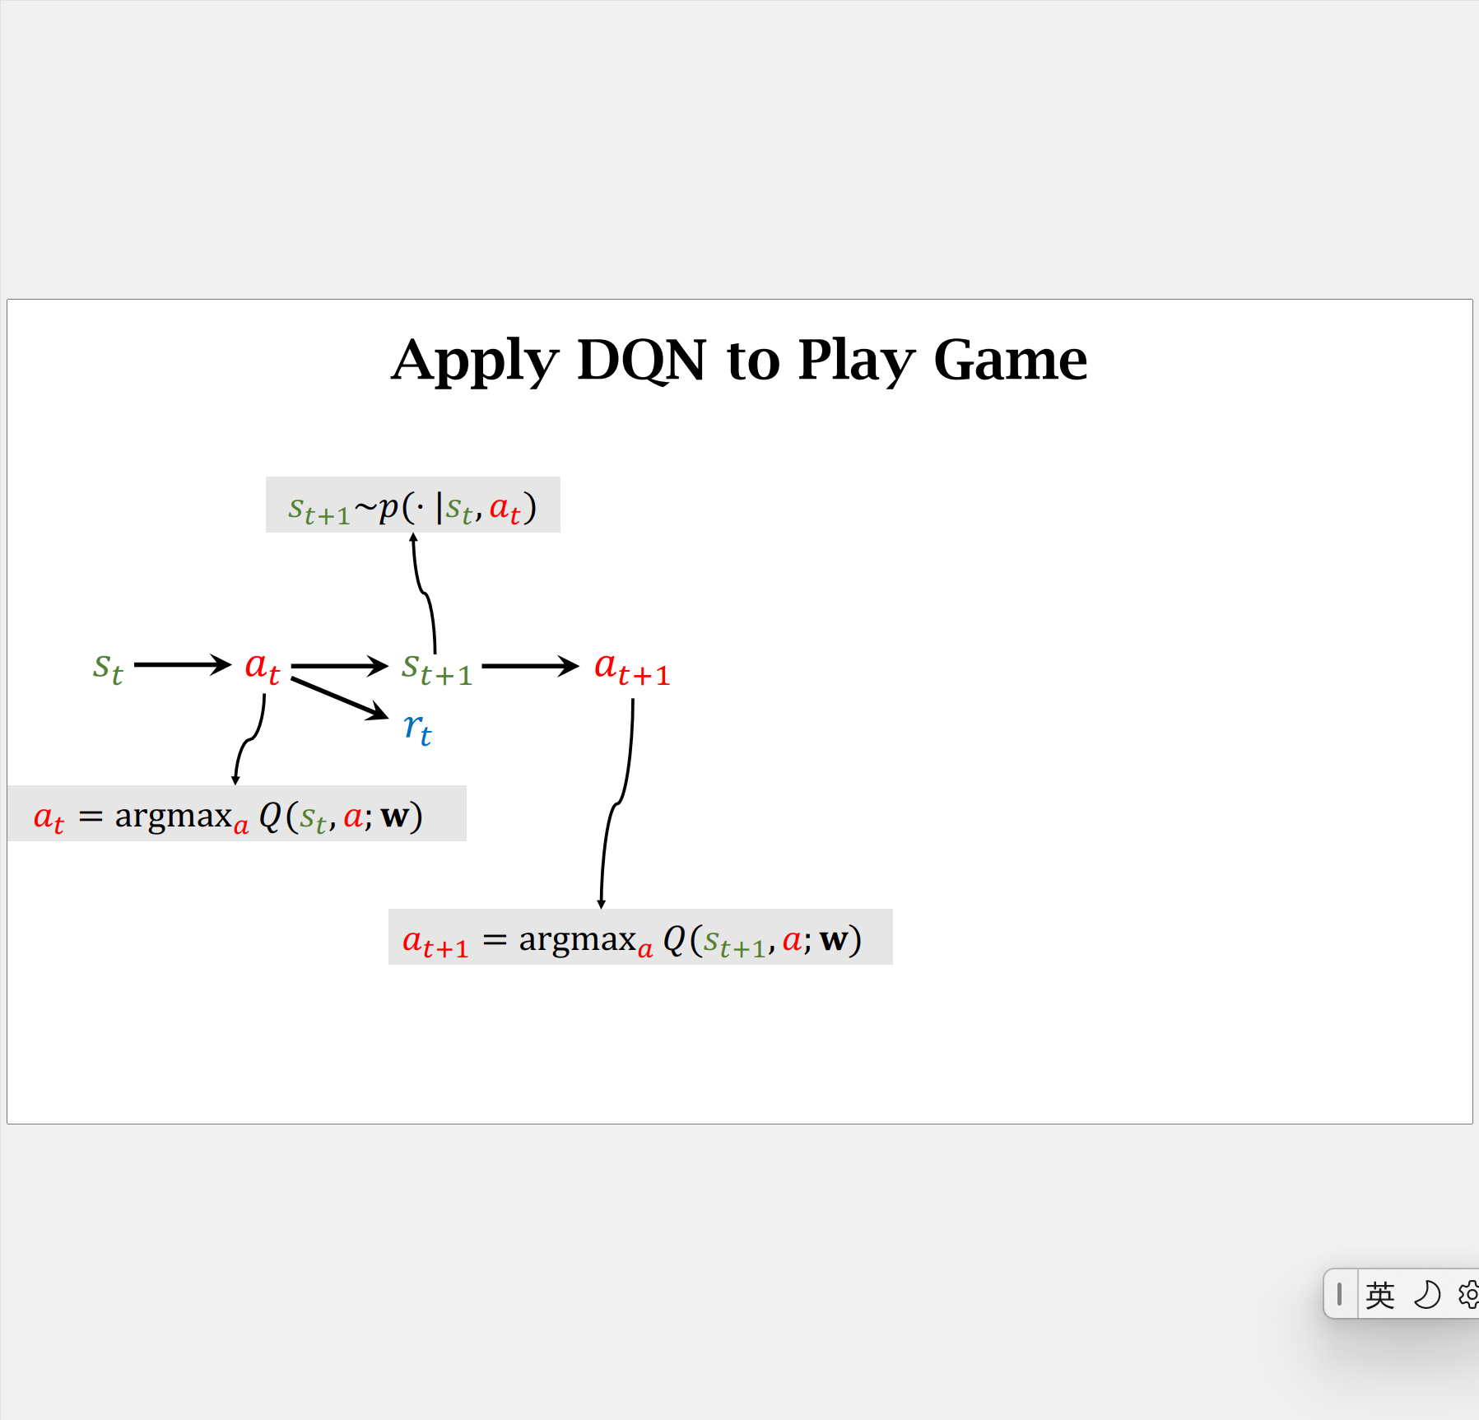
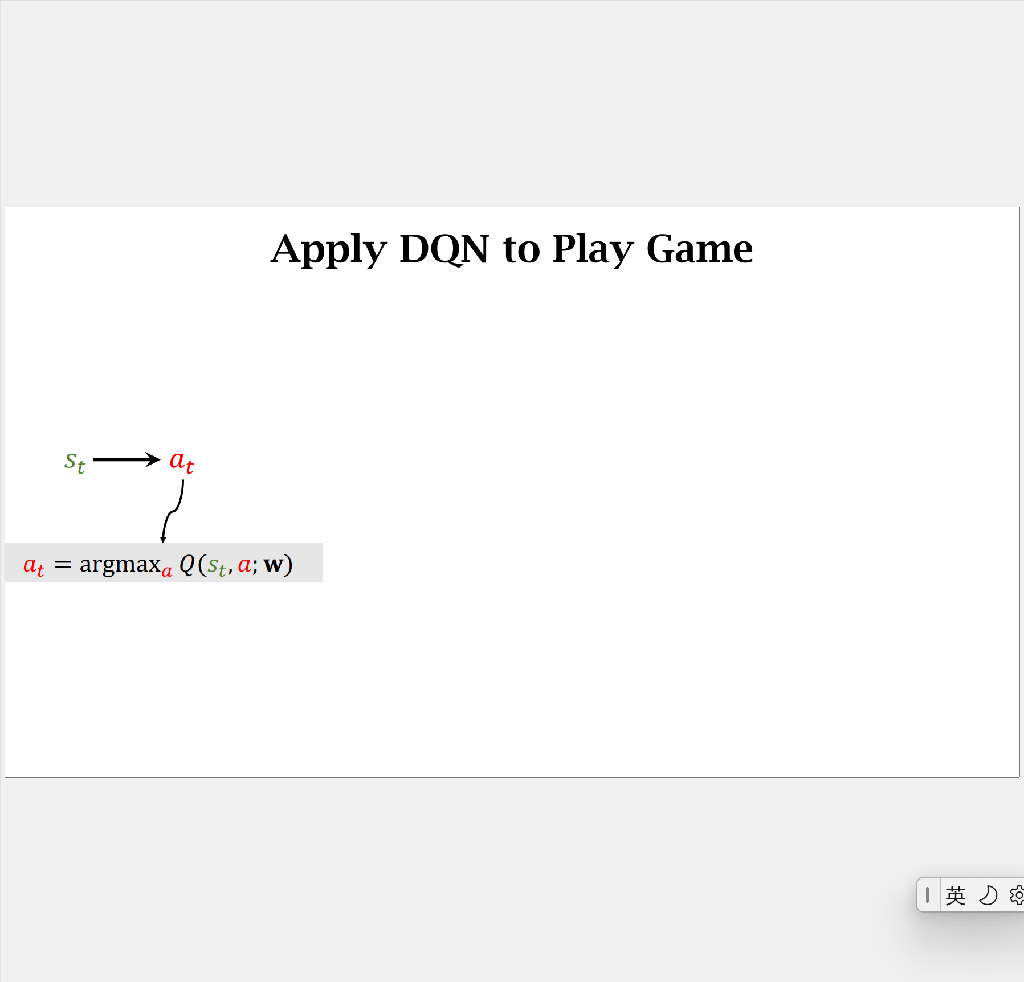
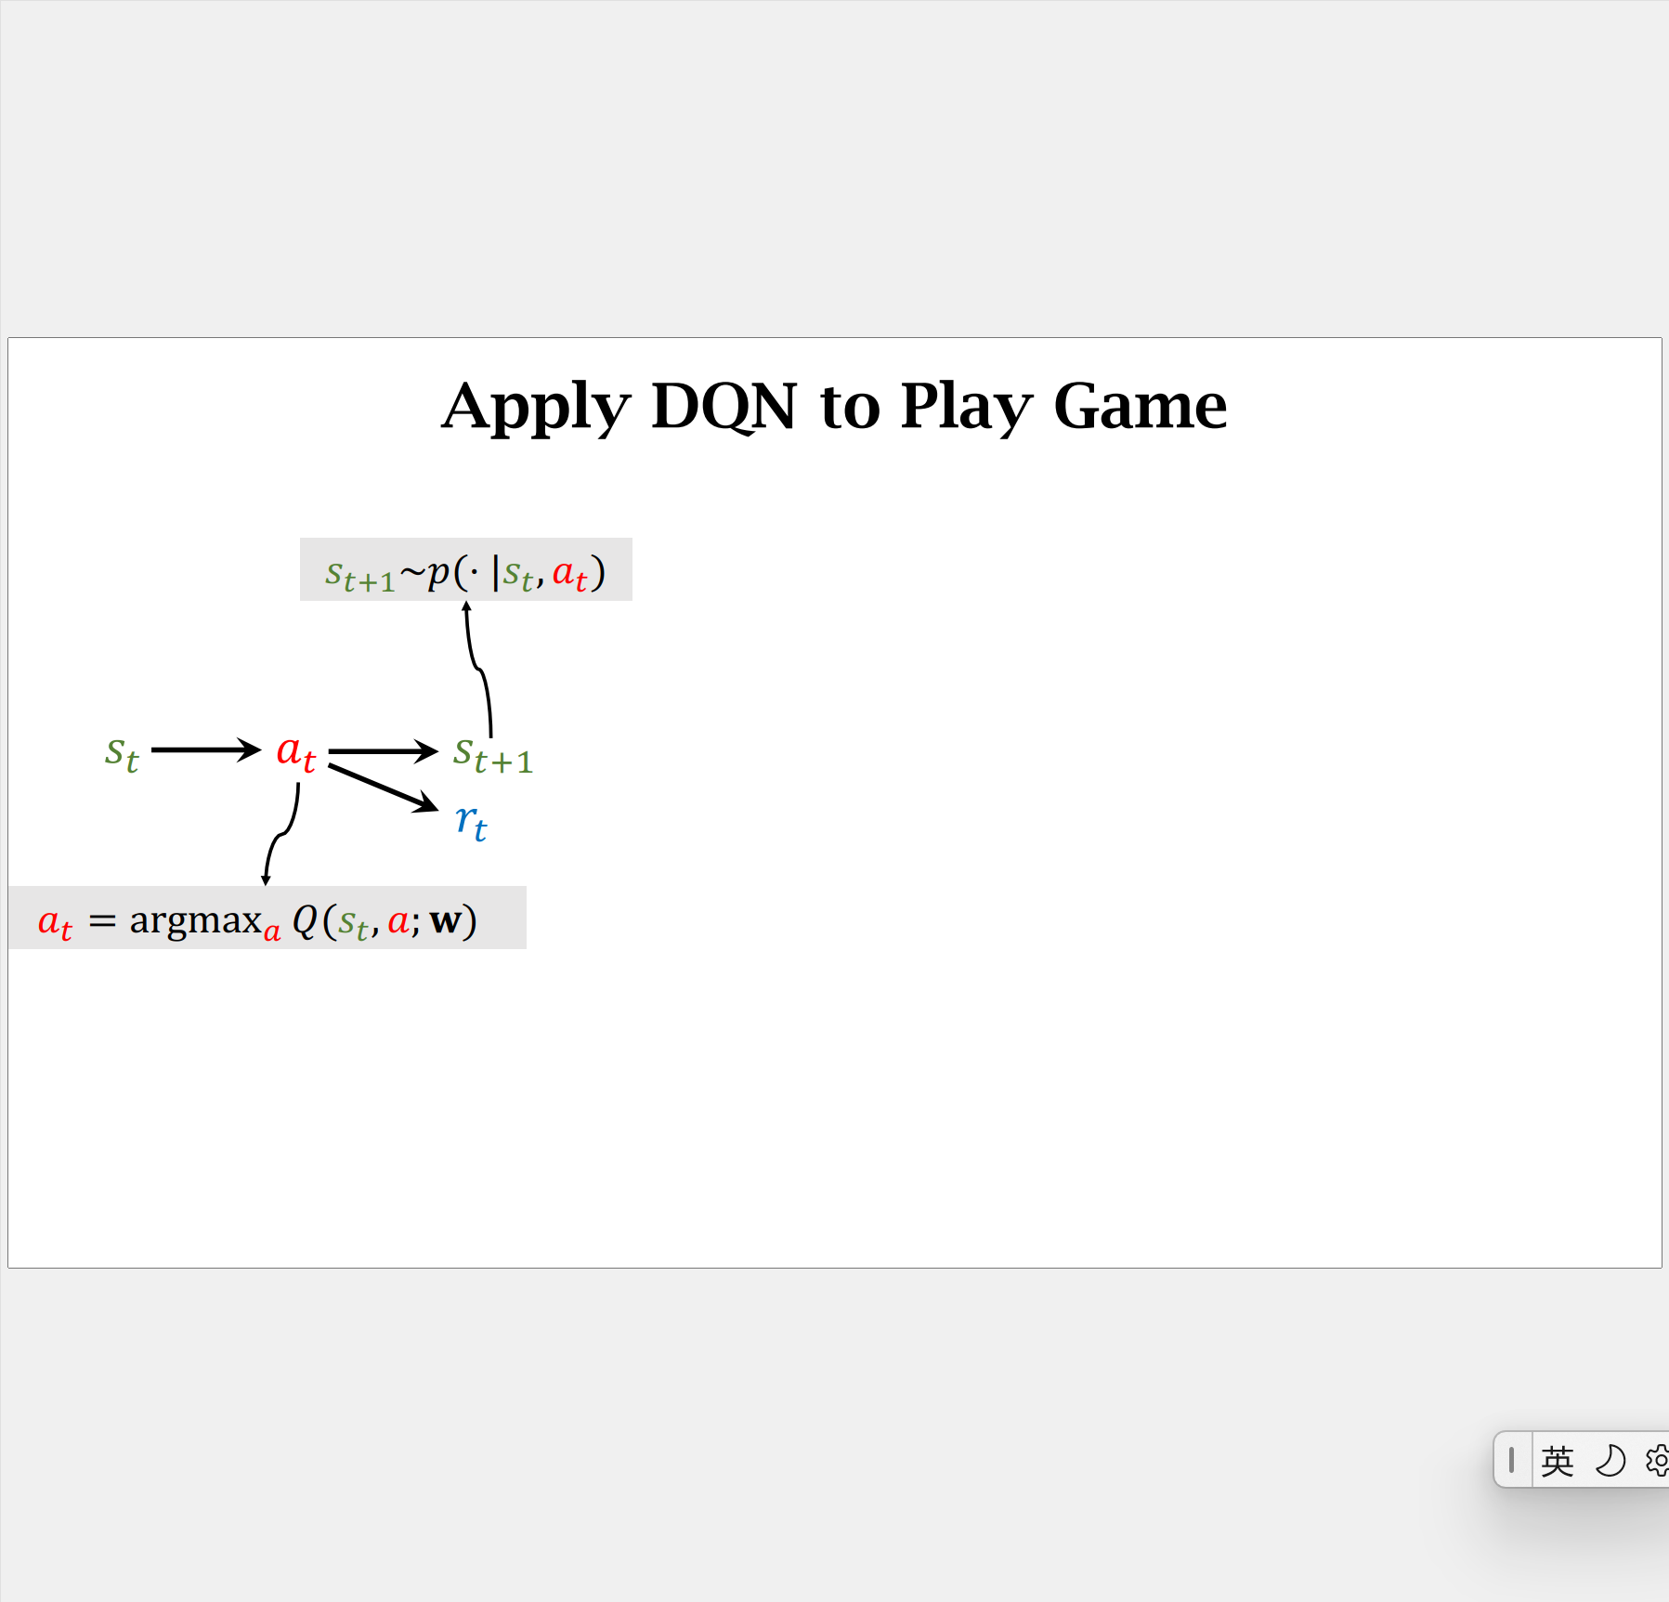
Applying DQN to the RL Process

Slide 31
Training the DQN: Temporal Difference (TD) Learning
The key is always to get the “reward”. However, the rewards are usually not (immediately) observable!
More often, we only know the “reward” on the final action (terminal state). All other actions will have 0 immediate rewards!
How to predict the total reward expected over the future?
Temporal Difference Learning (TD Learning) – predicting a variable’s future value in a sequence of states.
In general: rather than attempting to calculate the total future reward, TD learning attempts to predict the combination of immediate reward and its own reward prediction at the next moment in time.
Better describe with an example!

Slide 32
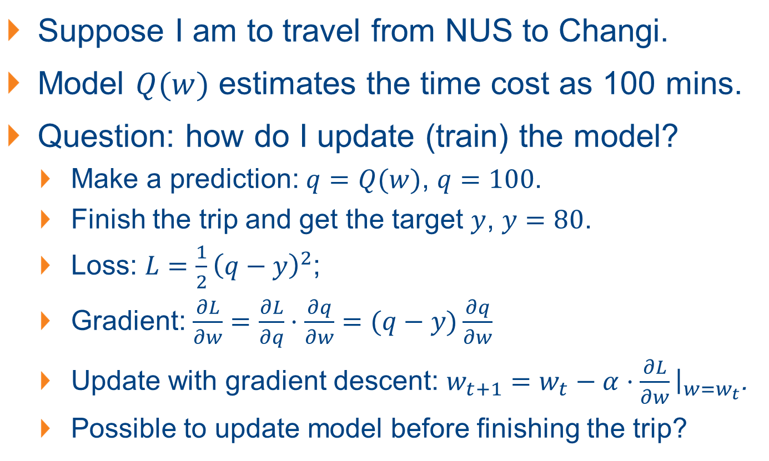
TD Learning: An Example
NUS
Suppose I am to travel from NUS to Changi.
Model $Q(w)$ estimates the time cost as 100 mins.
Question: how do I update (train) the model?
Make a prediction: $q=Q(w)$, $q=100$.
Finish the trip and get the target $y$, $y=80$.
Loss: $L=\frac{1}{2}{\left(q−y\right)}^{2}$;
Gradient: $\frac{∂L}{∂w}=\frac{∂L}{∂q}⋅\frac{∂q}{∂w}=(q−y)\frac{∂q}{∂w}$
Update with gradient descent: $w_{t+1}=w_{t}−α⋅\frac{∂L}{∂w}{\left.​\right|}_{w=w_{t}}$.
Possible to update model before finishing the trip?
100 minutes (est.)
80 minutes (actual)
Changi

Slide 33

TD Learning: An Example
NUS
30 minutes (actual)
Possible to update model before finishing the trip?
Get a better $w$ for the model when arriving mid-way (Bugis).
Model’s estimate: NUS → Changi, 100 mins (est.)
When arrive at Bugis, the actual time cost: 30 mins (actual)
Model now updates its estimate:
Bugis → Changi: 60 mins (est.)
Compare: The model’s estimate $Q\left(w\right)=100$ v.s. Updated estimate: $30+60=90 →$ TD target.
The TD target is a more reliable estimate.
Bugis
100 minutes (est.)
60 minutes (est.)
Changi

Slide 34

TD Learning with TD Target
Compare: The model’s estimate $Q\left(w\right)=100$ v.s. Updated estimate: $30+60=90 →$ TD target.
The TD target is a more reliable estimate.
We can define the loss and update with the TD target! (Instead of the actual target) (Advantage?)
Loss: $L=\frac{1}{2}{\left(Q(w)−y\right)}^{2}$;
Gradient: $\frac{∂L}{∂w}=\frac{∂L}{∂q}⋅\frac{∂q}{∂w}=(100−90)\frac{∂q}{∂w}$
Update with gradient descent: $w_{t+1}=w_{t}−α⋅\frac{∂L}{∂w}{\left.​\right|}_{w=w_{t}}$.

Slide 35

Applying TD Learning to DQN
In the previous example, we have the following equation:
$T_{NUS→Changi}≈T_{NUS→Bugis}+T_{Bugis→Changi}$
Model’s Est. Actual Time Model’s Est.
In deep reinforcement learning (DRL), we have:
$Q\left(s_{t}, a_{t};w\right)≈r_{t}+γ⋅Q(s_{t+1}, a_{t+1};w)$
Recall: Discounted Return: cumulative discounted future reward
$$U_{t}=R_{t}+γR_{t+1}+γ^{2}R_{t+2}+γ^{3}R_{t+3}+…$$
$$=R_{t}+γ\left(R_{t+1}+γR_{t+2}+γ^{2}R_{t+3}+…\right)$$
$$R_{t+1}+γR_{t+2}+γ^{2}R_{t+3}+…=U_{t+1}$$
Identity: $U_{t}=R_{t}+γU_{t+1}$

Slide 36



Applying TD Learning to DQN
Identity: $U_{t}=R_{t}+γU_{t+1}$
Training DQN with TD Learning:
DQN’s output, $Q(s_{t}, a_{t};w)$, is an estimate of $U_{t}$;
DQN’s output, $Q(s_{t+1}, a_{t+1};w)$, is an estimate of $U_{t+1}$;
Thus: $Q\left(s_{t}, a_{t};w\right)=r_{t}+γQ\left(s_{t+1}, a_{t+1};w\right)$
Estimate of $U_{t}$
Estimate of $U_{t+1}$
Prediction
TD Target

Slide 37

Training DQN with TD Learning
Prediction: $Q(s_{t}, a_{t};w_{t})$.
TD target: $y_{t}=r_{t}+γQ\left(s_{t+1}, a_{t+1};w_{t}\right)$
Equivalently: $y_{t}=r_{t}+γ\max_{a}{Q\left(s_{t+1}, a_{t};w_{t}\right)}$
Loss: $L_{t}=\frac{1}{2}{\left[Q\left(s_{t}, a_{t};w\right)−y_{t}\right]}^{2}$
Update w/ gradient descent: $w_{t+1}=w_{t}−α\frac{∂L_{t}}{∂w}{\left.​\right|}_{w=w_{t}}$.

Slide 38

Training DQN with TD Learning
One iteration of TD Learning for DQN training is as follows:
1. Observe state $S_{t}=s_{t}$ and perform action $A_{t}=a_{t}$;
2. Predict the value $q_{t}=Q(s_{t}, a_{t};w_{t})$;
3. Differentiate the value network: $d_{t}=\frac{∂Q\left(s_{t},a_{t};w\right)}{∂w}{\left.​\right|}_{w=w_{t}}$;
4. Environment provides the new state $s_{t+1}$ and reward $r_{t}$;
5. Compute TD target: $y_{t}=r_{t}+γ\max_{a}{Q(s_{t+1}, a;w_{t})}$;
6. Gradient descent: $w_{t+1}=w_{t}−α\left(q_{t}−y_{t}\right)d_{t}$.

Slide 39

Value-based v.s. Policy-based RL
Limitations for value-based RL methods?
No explicit policy is learned, just the Q-function!
$θ^{⋆}=\arg{\max_{θ}{𝔼_{S\sim p_{θ}(S)}[V_{π}\left(S\right)]}}=$ $\arg{\max_{θ}{𝔼_{τ\sim p_{θ}(τ)}[\sum_{t}{r(s_{t},a_{t})}]}}$
Hyperparameter $θ$: w.r.t. the policy $π$ ($π_{θ}$)
Is it possible to directly learn the policy function $π(a|s)$?
Recall: the policy function $π(a|s)$ is a probability density function (PDF):
Takes state $s$ as the input and output the probabilities for all actions, where the sample action $a$ is randomly drawn from the distribution.

Slide 40


Directly Learning a Policy Function $π$?
Can we directly learn a policy function $π(a|s)$?
Possible……But if there are only a few states and actions.
The method: draw a table (matrix) and learn the entries.
What if there are too many (or even infinite) states/actions?

Slide 41


Policy Network $π(a|s;θ)$
Policy network: leverage a neural network to approx. $π(a|s)$.
Expression: $π(a|s;θ)$, where $θ$ is the trainable parameters.
Note that: $\sum_{a∈𝒜}{π(a|s;θ)}=1$ (all possible actions)
Leverage the “Softmax” activation.
The key to train policy network: approx. (state-)value function!

Slide 42

Recap: (State-)Value Function and Policy-based RL
The state-value (value) function: the total reward from state $s_{t}$: $V_{π}\left(s_{t}\right)=𝔼_{A}\left[Q_{π}\left(s_{t}, A\right)\right]$ ($𝔼$ integrates out action $A\sim π(A|s_{t})$).
$$V_{π}\left(s_{t}\right)=𝔼_{A}\left[Q_{π}\left(s_{t}, A\right)\right]=\sum_{a}{π\left(a | s_{t}\right)⋅Q_{π}(s_{t}, a)}$$
With policy network, we approx. $V_{π}\left(s_{t}\right)$ by:
$$V_{π}\left(s_{t};θ\right)=\sum_{a}{π\left(a | s_{t};θ\right)⋅Q_{π}(s_{t}, a)}$$
Recall: the value function evaluate how good the situation is in state $s$ with policy $π$, the objective is $𝔼_{S}[V_{π}(S)]$.
Policy-based RL: learn $θ$ to maximize $J\left(θ\right)=𝔼_{S}[V_{π}(S;θ)]$.

Slide 43

Policy-based Reinforcement Learning
Policy-based RL: learn $θ$ to maximize $J\left(θ\right)=𝔼_{S}[V_{π}(S;θ)]$.
How to improve $θ$? (Note the objective is Maximize)
Policy gradient Ascent!
Observe the state $s$, update policy: $θ←θ+β⋅\frac{∂V\left(s;θ\right)}{∂θ}$.
$\frac{∂V\left(s;θ\right)}{∂θ}$ is defined as the policy gradient.
How to compute with (and thus update the network) with policy gradient – simplify the policy gradient first.

Slide 44


Deriving the Policy Gradient
The policy gradient is the derivative of $V(s;θ)$ w.r.t. $θ$.
$$\frac{∂V\left(s;θ\right)}{∂θ}=\frac{∂\sum_{a}{π\left(a | s;θ\right)⋅Q_{π}(s,a)}}{∂θ}=\sum_{a}{\frac{∂π\left(a | s;θ\right)⋅Q_{π}(s,a)}{∂θ}}$$
$$=\sum_{a}{\frac{∂π\left(a | s;θ\right)}{∂θ}⋅Q_{π}(s,a)}$$
Note: this derivation is over-simplified and not rigorous (why?)
Further, note that the following equation exist:
$\frac{∂\log{f\left(x\right)}}{∂x}=\frac{1}{f\left(x\right)}\frac{∂f\left(x\right)}{∂x}$, we can further derive the policy gradient:
Pretend that $Q_{π}$ is independent of $θ$

Slide 45

Deriving the Policy Gradient
$\frac{∂V\left(s;θ\right)}{∂θ}=\sum_{a}{\frac{∂π\left(a | s;θ\right)}{∂θ}⋅Q_{π}}=\sum_{a}{π\left(a | s;θ\right)\frac{∂\log{π\left(a | s;θ\right)}}{∂θ}⋅Q_{π}(s,a)}$
Given $\frac{∂\log{f\left(x\right)}}{∂x}=\frac{1}{f\left(x\right)}\frac{∂f\left(x\right)}{∂x},f(x)\frac{∂\log{f\left(x\right)}}{∂x}=\frac{∂f\left(x\right)}{∂x}$
Further, recall that the policy is essentially a probability:
$$\frac{∂V\left(s;θ\right)}{∂θ}=\sum_{a}{π\left(a | s;θ\right)\frac{∂\log{π\left(a | s;θ\right)}}{∂θ}⋅Q_{π}(s,a)}$$
$$=𝔼_{A}[\frac{∂\log{π\left(a | s;θ\right)}}{∂θ}Q_{π}(s,A)]$$
The expectation is taken w.r.t. the random variable $A\sim π(A|s;θ)$.

Slide 46

Calculate the Policy Gradient
Define the policy gradient: $\frac{∂V\left(s;θ\right)}{∂θ}=𝔼_{A}\left[\frac{∂\log{π\left(a | s;θ\right)}}{∂θ}Q_{π}\left(s,A\right)\right]$:
The steps to calculate them for policy update:
1. Randomly sample an action $\hat{a}$ according to $π\left(\hat{a}\right|s;θ)$.
2. Calculate $g\left(\hat{a}, θ\right)=\frac{∂\log{π\left(\hat{a} | s;θ\right)}}{∂θ}Q_{π}\left(s,\hat{a}\right)$.
By the definition of $g$, $𝔼_{A}\left[g\left(A, θ\right)\right]=\frac{∂V\left(s;θ\right)}{∂θ}$, i.e., $g\left(\hat{a}, θ\right)$ is an unbiased estimate of $\frac{∂V\left(s;θ\right)}{∂θ}$.
3. Use $g\left(\hat{a}, θ\right)$ as an approximation to the policy gradient $\frac{∂V\left(s;θ\right)}{∂θ}$.

Slide 47


Update Policy Network with Policy Gradient
The overall algorithm for training the policy network as follows:
1. Observe the state $s_{t}$;
2. Randomly sample action $a_{t}$ according to $π(a_{t}|s_{t};θ_{t})$;
3. Compute $q_{t}≈Q_{π}(s_{t}, a_{t})$ (some estimate);
4. Differentiate policy network: $d_{θ,t}=\frac{∂\log{π(a_{t}|s_{t};θ)}}{∂θ}{\left.​\right|}_{θ=θ_{t}}$;
5. (Approximate) policy gradient: $g\left(a_{t}, θ_{t}\right)=q_{t}⋅d_{θ,t}$;
6. Update policy network: $θ_{t+1}=θ_{t}+β⋅g(a_{t}, θ_{t})$.
Pretend that $Q_{π}$ is independent of $θ$
How?

Slide 48

Estimate Q-Function Value for Policy Network
Compute $q_{t}≈Q_{π}(s_{t}, a_{t})$ (some estimate);
Option 1: REINFORCE:
Play the game to the end and generate the trajectory:
$$s_{1},a_{1},r_{1},s_{2},a_{2},r_{2},…, s_{T}, a_{T}, r_{T}$$
Compute the discounted return $u_{t}=\sum_{k=t}^{T}{γ^{k−t}r_{k}}$, for all $t$.
Since $Q_{π}\left(s_{t}, a_{t}\right)=𝔼[U_{t}]$, we can use $u_{t}$ to approx. $Q_{π}(s_{t}, a_{t})$.
We can leverage $q_{t}=u_{t}$.

Slide 49


Estimate Q-Function Value for Policy Network
Compute $q_{t}≈Q_{π}(s_{t}, a_{t})$ (some estimate);
Option 2: Approx. $Q_{π}$ using a neural network → Actor-Critic.
Policy network (actor) + Q-function network (critic).

